Slide 1
Model Based Deep Reinforcement Learning
Imagination-Augmented Agents – Successor Features for Transfer
May 2019
Ioannis Miltiadis Mandralis
Seminar on Deep Reinforcement Learning
ETH Zürich

Slide 2
Overview
Imagination Augmented Agents
Robust to model inaccuracy
Achieves performance with less data
I2A

Slide 3
Overview
Successor Features for Transfer
Value function representation that decouples dynamics from rewards
Integrates transfer into RL framework
$$Q^{π}\left(s,a\right)=ψ^{π}{\left(s,a\right)}^{T}w$$
Successor features

Slide 4
Imagination-Augmented Agents for Deep Reinforcement Learning
Théophane Weber et. al.
DeepMind
Feb 2018

Slide 5
I2A Architecture

Slide 6
1. Imagination Core

Slide 7
1. Imagination Core

Slide 8
1. Imagination Core

Slide 9
1. Imagination Core

Slide 10
1. Imagination Core

Slide 11
1. Imagination Core
Input observation…

Slide 12
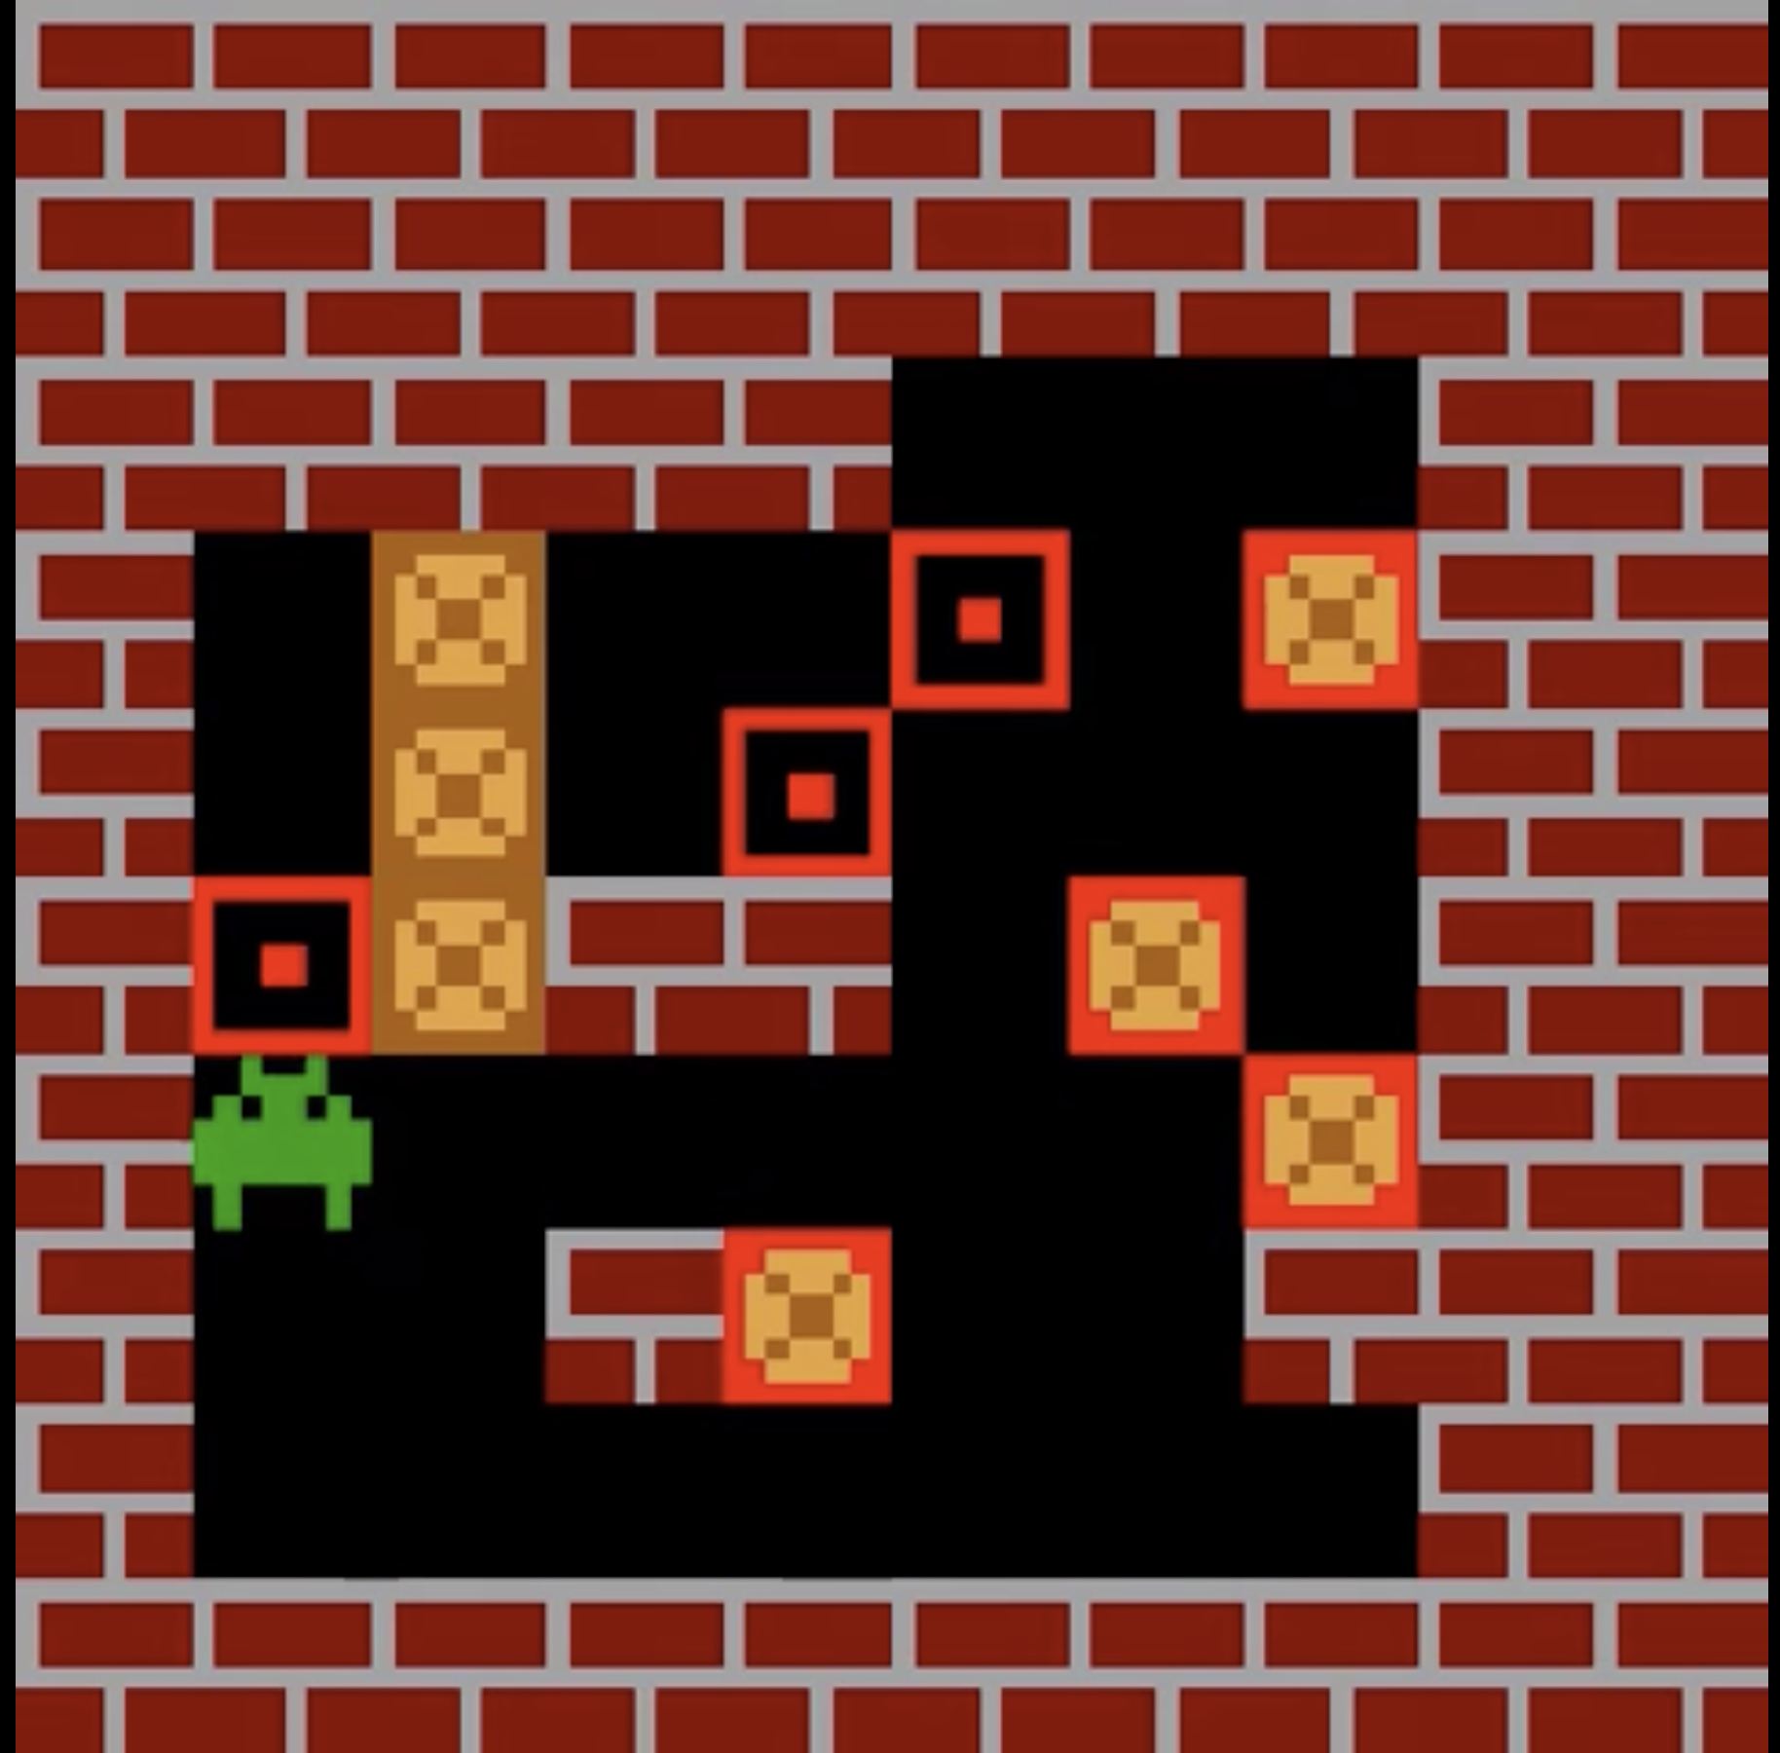
1. Imagination Core
Input observation…
Actually a frame

Slide 13
1. Imagination Core
Input observation…
Actually a frame
Predict action using policy $\hat{π}$ (more later)

Slide 14
1. Imagination Core
Input observation…
Actually a frame
Predict action using policy $\hat{π}$ (more later)
Obtain imagined frame and reward

Slide 15
1. Imagination Core
Input observation…
Actually a frame
Predict action using policy $\hat{π}$ (more later)
Obtain imagined frame and reward
How ?

Slide 16
1. Imagination Core
Environment Model

Slide 17
1. Imagination Core
Environment Model

Slide 18
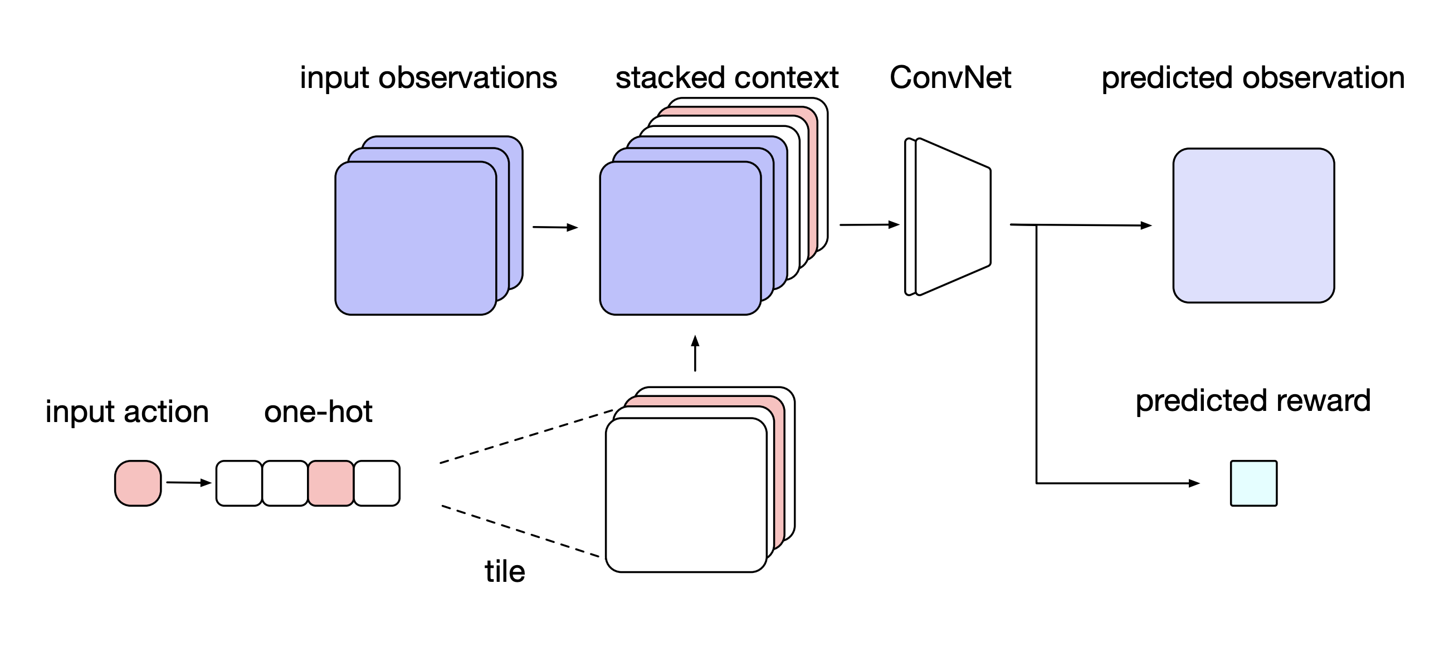
1. Imagination Core
Environment Model

Slide 19
2. Rollout Encoder

Slide 20
2. Rollout Encoder

Slide 21
2. Rollout Encoder
Blackbox
Input $o_{t}$
Output – rollout encoding

Slide 22
2. Rollout Encoder
Blackbox
Input $o_{t}$
Output – rollout encoding

Slide 23
2. Rollout Encoder
Step 1
Imagine future

Slide 24
2. Rollout Encoder
Step 1
Imagine future

Slide 25
2. Rollout Encoder
Step 1
Imagine future

Slide 26
2. Rollout Encoder
Step 2
Encode

Slide 27
2. Rollout Encoder
Step 2
Encode
Pass through CNN
CNN

Slide 28
2. Rollout Encoder
Step 2
Encode
Pass through CNN
Pass through LSTM

Slide 29
2. Rollout Encoder
Step 2
Encode
Pass through CNN
Pass through LSTM
CNN

Slide 30
2. Rollout Encoder
Step 2
Encode
Pass through CNN
Pass through LSTM

Slide 31
2. Rollout Encoder
Step 2
Encode
Pass through CNN
Pass through LSTM

Slide 32
2. Rollout Encoder
Step 2
Encode
Pass through CNN
Pass through LSTM
Obtain Rollout Encoding

Slide 33
2. Rollout Encoder

Slide 34
2. Rollout Encoder

Slide 35
3. Aggregate rollout encodings

Slide 36
3. Aggregate rollout encodings

Slide 37
3. Aggregate rollout encodings
One rollout for each action in set $𝒜$

Slide 38
3. Aggregate rollout encodings

Slide 39
3. Aggregate rollout encodings

Slide 40
3. Aggregate rollout encodings

Slide 41
3. Aggregate rollout encodings

Slide 42
3. Aggregate rollout encodings

Slide 43
3. Aggregate rollout encodings
CNN
Model-Free Architecture
Multilayer CNN without FC layers

Slide 44
3. Aggregate rollout encodings
CNN

Slide 45
3. Aggregate rollout encodings
CNN

Slide 46
3. Aggregate rollout encodings
Concatenate and pass through FC Layer
FC
CNN

Slide 47
3. Aggregate rollout encodings
NN outputs
Logits of $π$
Value $V$
CNN

Slide 48
Training
Overall gradient can be summarized
$$g=g_{θ}+g_{θ_{v}}+g_{θ, entropy}+g_{\hat{θ}, distill}$$

Slide 49
Training
A3C policy gradient
$$g_{θ}=∇_{θ}\log{π\left(a_{t} | o_{t};θ\right)\hat{A}(o_{t}, a_{t})}$$
Advantage estimate
$$\hat{A}\left(o_{t}, a_{t}\right)=\left(\sum_{t≤t^{′}≤t+k}{γ^{t^{′}−t}r_{t^{′}}}\right)+γ^{k+1}V\left(o_{t+k+1};θ_{v}\right)−V(o_{t};θ_{v})$$

Slide 50
Training
Value function $V(o_{t};θ_{v})$ updated toward bootstrapped $k$-step return
$$g_{θ_{v}}=−\hat{A}\left(o_{t}, a_{t}\right)∇_{θ_{v}}V\left(o_{t};θ_{v}\right)$$

Slide 51
Training
Add entropy regularizer to encourage exploration
$$g_{θ, entropy}=∇_{θ}λ_{entropy}\sum_{a_{t}}{π\left(a_{t} | o_{t};θ\right)\log{π\left(a_{t} | o_{t};θ\right)}}$$

Slide 52
Training
How do we train rollout policy $\hat{π}$ ?
“Distill imagination-augmented policy into a model-free policy”
$$g_{\hat{θ}, distill}=∇_{\hat{θ}}λ_{distill}\sum_{a_{t}}{π\left(a | o_{t}\right)\log{\hat{π}\left(a | o_{t};\hat{θ}\right)}}$$

Slide 53
Experiments
Aim: Push boxes on target
Irreversible moves !
Benefit from planning.
Random levels – cannot memorize
Trained I2A playing Sokoban

Slide 54
Experiments
Baseline Models
Model-Free Agent
Large Model-Free Agent – deeper, more parameters than I2A
Copy Model Agent

Slide 55
Experiments
Baseline Models
Model-Free Agent
Large Model-Free Agent – deeper, more parameters than I2A
Copy Model Agent
$$Id$$

Slide 56
Experiments
Baseline Models
Model-Free Agent
Large Model-Free Agent – deeper, more parameters than I2A
Copy Model Agent
$$Id$$
$$Id$$

Slide 57
Experiments
Baseline Models
Model-Free Agent
Large Model-Free Agent – deeper, more parameters than I2A
Copy Model Agent
$$Id$$
$$Id$$

Slide 58
Experiments
Baseline Models
Model-Free Agent
Large Model-Free Agent – deeper, more parameters than I2A
Copy Model Agent
$$Id$$
Same number of learnable parameters !
$$Id$$

Slide 59
Experiments
Baseline Models
Model-Free Agent
Large Model-Free Agent – deeper, more parameters than I2A
Copy Model Agent
$$Id$$
Same number of learnable parameters !
LSTM network with skip connections.
$$Id$$

Slide 60
Experiments
I2A vs. Baselines

Slide 61
Experiments
Imperfect Models
Error Propagation

Slide 62
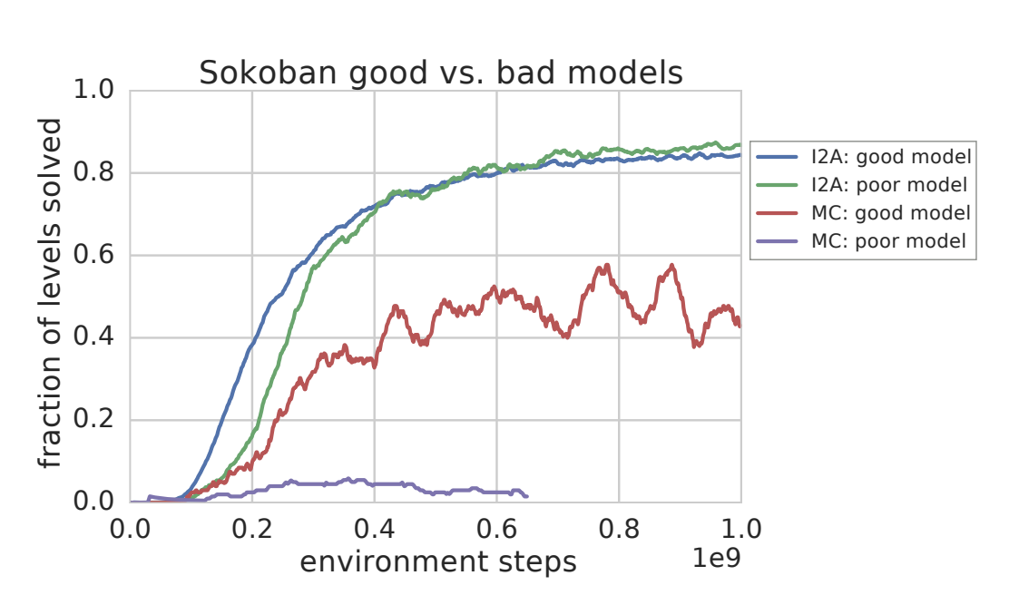
Experiments
Learns to ignore noisy parts of rollout.
Imperfect Models

Slide 63
Experiments
Generalization
Learning one model for many tasks – MiniPacman (Marginal cost zero)
$w_{rew}=$ (moving, eating food, eating pill, eating ghost, eaten by ghost)
MiniPacman solving “Avoid” Task

Slide 64
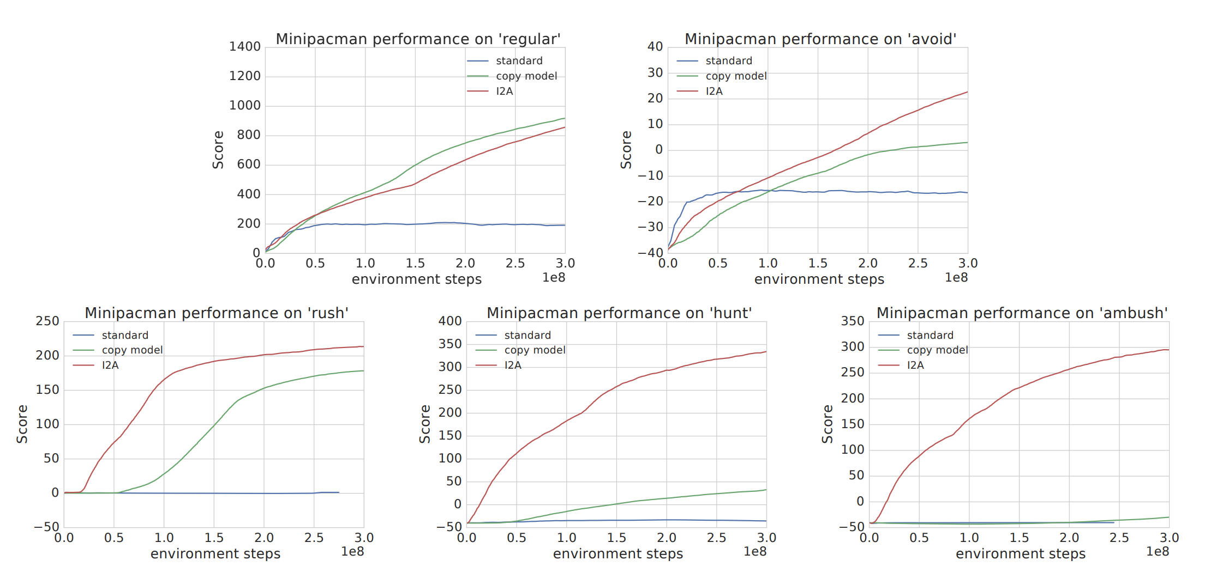
Experiments

Slide 65
Successor Features for Transfer in Reinforcement Learning
André Barreto et. al.
DeepMind
14 Feb 2018

Slide 66
Key idea
No rigid structure reflecting relationship between tasks like in hierarchical RL - flexible
Agent constructs a library of skills that can be reused to solve previously unseen tasks.
Free exchange of information across tasks !

Slide 67
Background
Action Value Function
$$Q^{π}\left(s,a\right)=𝔼\left[\sum_{i=0}^{∞}{γ^{i}R_{t+i+1}}|S_{t}=s, A_{t}=a \right]$$
Bellman Policy Improvement Theorem
“Acting Greedily w.r.t $Q^{π}\left(s,a\right)$ yields a new policy whose performance is no worse than the former’s”

Slide 68
Generalized Policy Improvement
New policy computed based on value functions of set of policies

Slide 69
Generalized Policy Improvement
New policy computed based on value functions of set of policies
$$π_{1}$$

Slide 70
Generalized Policy Improvement
New policy computed based on value functions of set of policies
$$π_{1}$$
$${\tilde{Q}}^{π_{1}}$$

Slide 71
Generalized Policy Improvement
New policy computed based on value functions of set of policies
$$π_{1}$$
$${\tilde{Q}}^{π_{1}}$$

Slide 72
Generalized Policy Improvement
New policy computed based on value functions of set of policies
$$π_{1}$$
$$π_{2}$$
$${\tilde{Q}}^{π_{1}}$$

Slide 73
Generalized Policy Improvement
New policy computed based on value functions of set of policies
$$π_{1}$$
$$π_{2}$$
$${\tilde{Q}}^{π_{2}}$$
$${\tilde{Q}}^{π_{1}}$$

Slide 74
Generalized Policy Improvement
New policy computed based on value functions of set of policies
$$π_{1}$$
$$π_{2}$$
$${\tilde{Q}}^{π_{1}}$$
$${\tilde{Q}}^{π_{2}}$$

Slide 75
Generalized Policy Improvement
New policy computed based on value functions of set of policies
$$π_{1}$$
$$π_{n}$$
$$π_{2}$$
$${\tilde{Q}}^{π_{1}}$$
$${\tilde{Q}}^{π_{2}}$$

Slide 76
Generalized Policy Improvement
New policy computed based on value functions of set of policies
$$π_{1}$$
$$π_{n}$$
$${\tilde{Q}}^{π_{n}}$$
$$π_{2}$$
$${\tilde{Q}}^{π_{1}}$$
$${\tilde{Q}}^{π_{2}}$$

Slide 77
Generalized Policy Improvement
New policy computed based on value functions of set of policies
How do we choose a new policy ?
$$π_{1}$$
$$π_{2}$$
$$⋱$$
$$π_{n}$$
$${\tilde{Q}}^{π_{1}}$$
$${\tilde{Q}}^{π_{2}}$$
$${\tilde{Q}}^{π_{n}}$$

Slide 78
Generalized Policy Improvement
New policy computed based on value functions of set of policies
How do we choose a new policy ?
$$π_{1}$$
$$π\left(s\right)∈\underset{a}{argmax}{\max_{i}{{\tilde{Q}}^{π_{i}}}(s, a)}$$
$$π_{2}$$
$$⋱$$
$$π_{n}$$
$${\tilde{Q}}^{π_{1}}$$
$${\tilde{Q}}^{π_{2}}$$
$${\tilde{Q}}^{π_{n}}$$

Slide 79
Generalized Policy Improvement
New policy computed based on value functions of set of policies
How do we choose a new policy ?
$$π_{1}$$
$$π\left(s\right)∈\underset{a}{argmax}{\max_{i}{{\tilde{Q}}^{π_{i}}}(s, a)}$$
$$π_{2}$$
$$⋱$$
$$π_{n}$$
$${\tilde{Q}}^{π_{1}}$$
$${\tilde{Q}}^{π_{2}}$$
$${\tilde{Q}}^{π_{n}}$$

Slide 80
Generalized Policy Improvement
New policy computed based on value functions of set of policies
How do we choose a new policy ?
$$π_{1}$$
$$π\left(s\right)∈\underset{a}{argmax}{\max_{i}{{\tilde{Q}}^{π_{i}}}(s, a)}$$
$$π_{2}$$
$$⋱$$
$$π_{n}$$
$${\tilde{Q}}^{π_{1}}$$
$${\tilde{Q}}^{π_{2}}$$
$${\tilde{Q}}^{π_{n}}$$

Slide 81
Generalized Policy Improvement
New policy computed based on value functions of set of policies
How do we choose a new policy ?
$$π_{1}$$
$$π\left(s\right)∈\underset{a}{argmax}{\max_{i}{{\tilde{Q}}^{π_{i}}}(s, a)}$$
$$π_{2}$$
$$Q^{π}\left(s,a\right)≥\max_{i}{Q^{π_{i}}}\left(s, a\right)−\frac{2}{1−γ}ε$$
$$⋱$$
$$π_{n}$$
$${\tilde{Q}}^{π_{1}}$$
$${\tilde{Q}}^{π_{2}}$$
$${\tilde{Q}}^{π_{n}}$$

Slide 82
Successor features
Model expected one step reward as:
$$r\left(s,a,s^{′}\right)=φ{\left(s,a,s^{′}\right)}^{T}w$$
features
weights

Slide 83
Successor features
Non-restrictive model, imagine following scenario :
$$φ\left(s,a,s^{′}\right)=\left[\begin{matrix}r\left(s,a,s^{′}\right) \\ 0 \\ ⋮ \\ 0\end{matrix}\right], w=\left[\begin{matrix}1 \\ 0 \\ ⋮ \\ 0\end{matrix}\right]$$
Can always recover reward by choosing $w$

Slide 84
Successor features
Rewrite $Q^{π}(s,a)$:
$$Q^{π}\left(s,a\right)=𝔼^{π}\left[r_{t+1}+γr_{t+2}+… | s,a\right]$$
$$=𝔼^{π}\left[φ_{t+1}^{T}w+γφ_{t+2}^{T}w+… | s,a\right]$$
$$=𝔼^{π}{\left[\sum_{i=t}^{∞}{γ^{i−t}}φ_{i+1} | s,a\right]}^{T}w$$
$$=ψ^{π}{\left(s,a\right)}^{T}w$$

Slide 85
Successor features
Rewrite $Q^{π}(s,a)$:
$$Q^{π}\left(s,a\right)=𝔼^{π}\left[r_{t+1}+γr_{t+2}+… | s,a\right]$$
$$=𝔼^{π}\left[φ_{t+1}^{T}w+γφ_{t+2}^{T}w+… | s,a\right]$$
$$=𝔼^{π}{\left[\sum_{i=t}^{∞}{γ^{i−t}}φ_{i+1} | s,a\right]}^{T}w$$
$$=ψ^{π}{\left(s,a\right)}^{T}w$$
Successor features, under $π$

Slide 86
Successor features
Rewrite $Q^{π}(s,a)$:
$$Q^{π}\left(s,a\right)=𝔼^{π}\left[r_{t+1}+γr_{t+2}+… | s,a\right]$$
$$=𝔼^{π}\left[φ_{t+1}^{T}w+γφ_{t+2}^{T}w+… | s,a\right]$$
$$=𝔼^{π}{\left[\sum_{i=t}^{∞}{γ^{i−t}}φ_{i+1} | s,a\right]}^{T}w$$
$$=ψ^{π}{\left(s,a\right)}^{T}w$$
Encodes Reward
Encodes dynamics, under 𝜋

Slide 87
Successor features
$ψ^{π}$ also satisfies a (vector valued) Bellman Equation:
$$ψ^{π}\left(s,a\right)=φ_{t+1}+γ𝔼[ψ^{π}\left(S_{t+1},π\left(S_{t+1}\right)\right)|s,a]$$
$φ$ plays the role of rewards

Slide 88
Transfer via Successor Features
Notation
$$M_{i}$$
$$π_{i}^{∗}$$
$$Q_{i}^{π_{i}^{∗}}$$
$$M_{j}$$
$$Q_{j}^{π_{i}^{∗}}$$

Slide 89
Transfer via Successor Features
Key idea
Evolve a “skill set” on $n$ different tasks
Apply $GPI\left(⋅\right)$to transfer knowledge to task $n+1$
$$GPI(\left\{Q_{n+1}^{π_{1}},Q_{n+1}^{π_{2}},…,Q_{n+1}^{π_{n}}\right\})$$

Slide 90
Transfer via Successor Features
Evolving a skill-set
Define task $M_{i}$ by defining its reward $r_{i}(s,a,s^{′})$
Design $\left(s,a,s^{′}\right)$ representation $φ$ (or learn it from data, $\tilde{φ}$)
Learn ${\tilde{w}}_{i}$by minimizing MSE Loss
$$𝔼_{(s,a,s^{′})\sim D}\left[{\left(r_{i}(s,a,s^{′})−\tilde{φ}{\left(s,a,s^{′}\right)}^{T}{\tilde{w}}_{i}\right)}^{2}\right]$$

Slide 91
Transfer via Successor Features
Evolving a skill-set
Learn ${\tilde{ψ}}^{π_{i}}$ using any RL method, e.g. Q–learning
$$𝔼_{(s,a,s^{′})\sim D}\left[{\left(\tilde{φ}\left(s,a,s^{′}\right)+γ{\tilde{ψ}}^{π_{i}}(s^{′},a^{′})−{\tilde{ψ}}^{π_{i}}(s,a)\right)}^{2}\right]$$

Slide 92
Transfer via Successor Features
Evolving a skill-set
Learn ${\tilde{ψ}}^{π_{i}}$ using any RL method, e.g. Q–learning
$$𝔼_{(s,a,s^{′})\sim D}\left[{\left(\tilde{φ}\left(s,a,s^{′}\right)+γ{\tilde{ψ}}^{π_{i}}(s^{′},a^{′})−{\tilde{ψ}}^{π_{i}}(s,a)\right)}^{2}\right]$$
Fixed Q-learning target value

Slide 93
Transfer via Successor Features
Applying GPI
Define new task $M_{j}$ by defining its reward $r_{j}\left(s,a,s^{′}\right)$
Learn ${\tilde{w}}_{j}$by minimizing MSE Loss (as before)
Compute new value function (simple algebra !)
$${\tilde{Q}}_{j}^{π_{i}}\left(s,a\right)={\tilde{ψ}}^{π_{i}}{\left(s, a\right)}^{T}{\tilde{w}}_{j}$$

Slide 94
Transfer via Successor Features
Applying GPI
Transfer is successful since
$Q_{j}^{π}\left(s,a\right)≥\max_{i}{Q_{j}^{π_{i}}}\left(s, a\right)−\frac{2}{1−γ}ε$

Slide 95
Transfer via Successor Features
Learning $Q_{j}^{π_{i}^{∗}}\left(s,a\right)$ is reduced to a much simpler problem of approximating $w_{j}$

Slide 96
Transfer via Successor Features
Note, the algorithm we just outlined is called
SFQL

Slide 97
Transfer via Successor Features
Note, the algorithm we just outlined is called
SFQL
Successor Features

Slide 98
Transfer via Successor Features
Note, the algorithm we just outlined is called
SFQL
Successor Features
Q-Learning

Slide 99
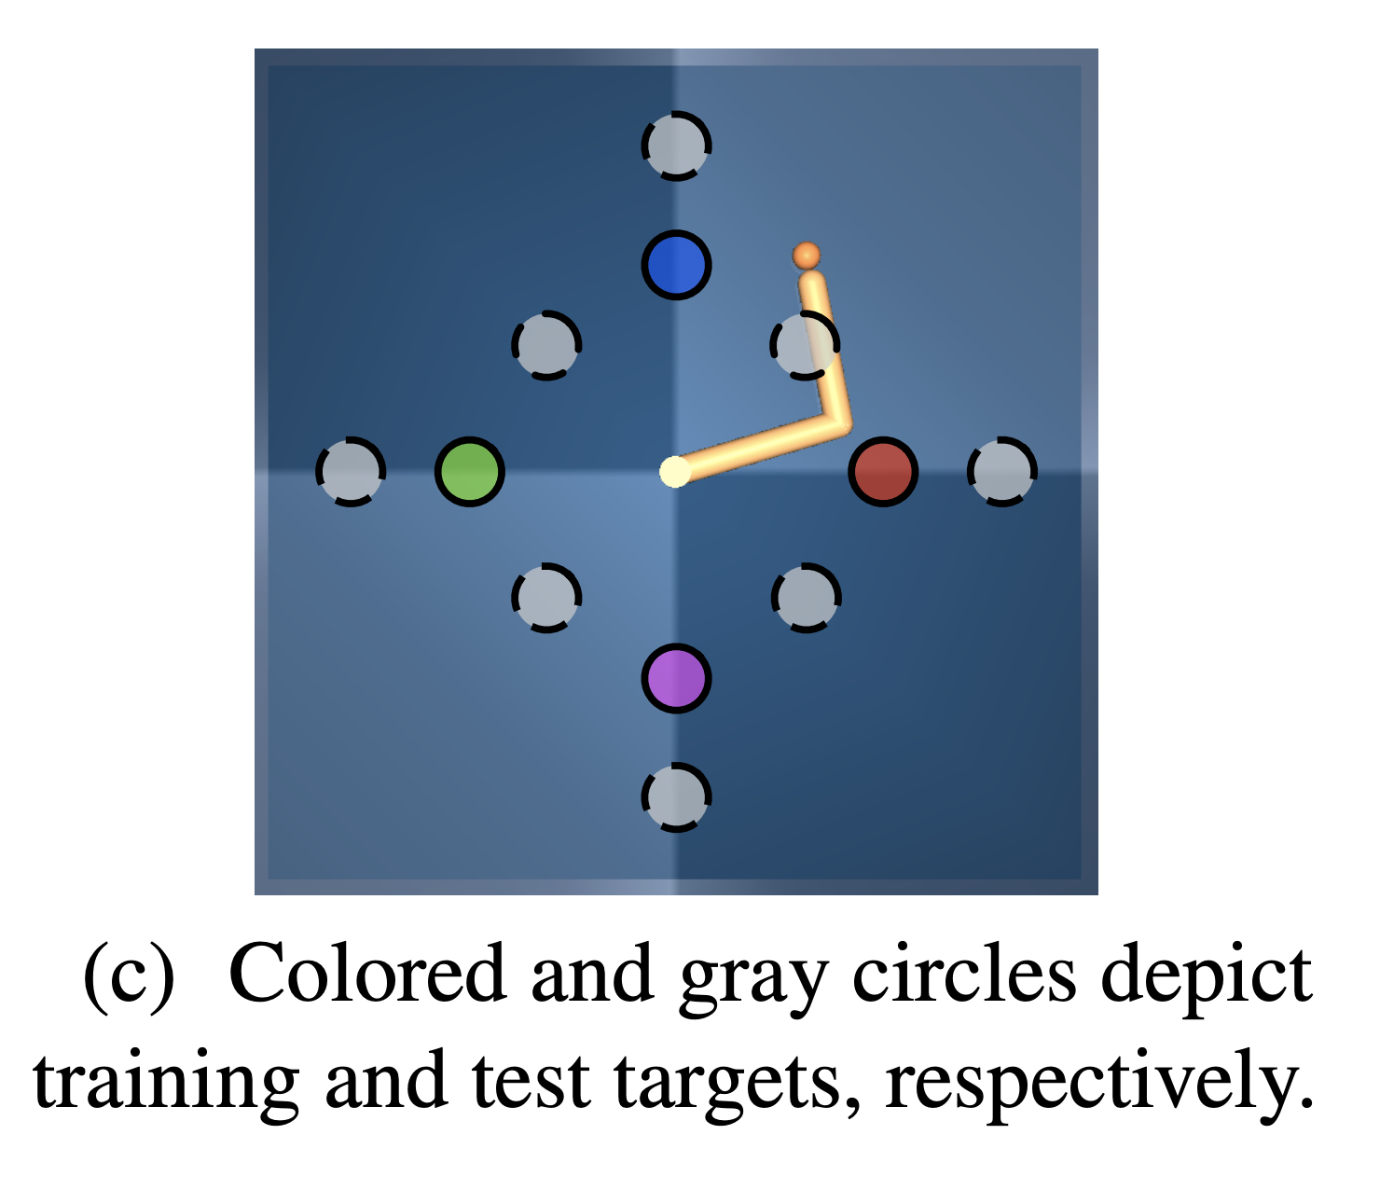
Experiments

Slide 100
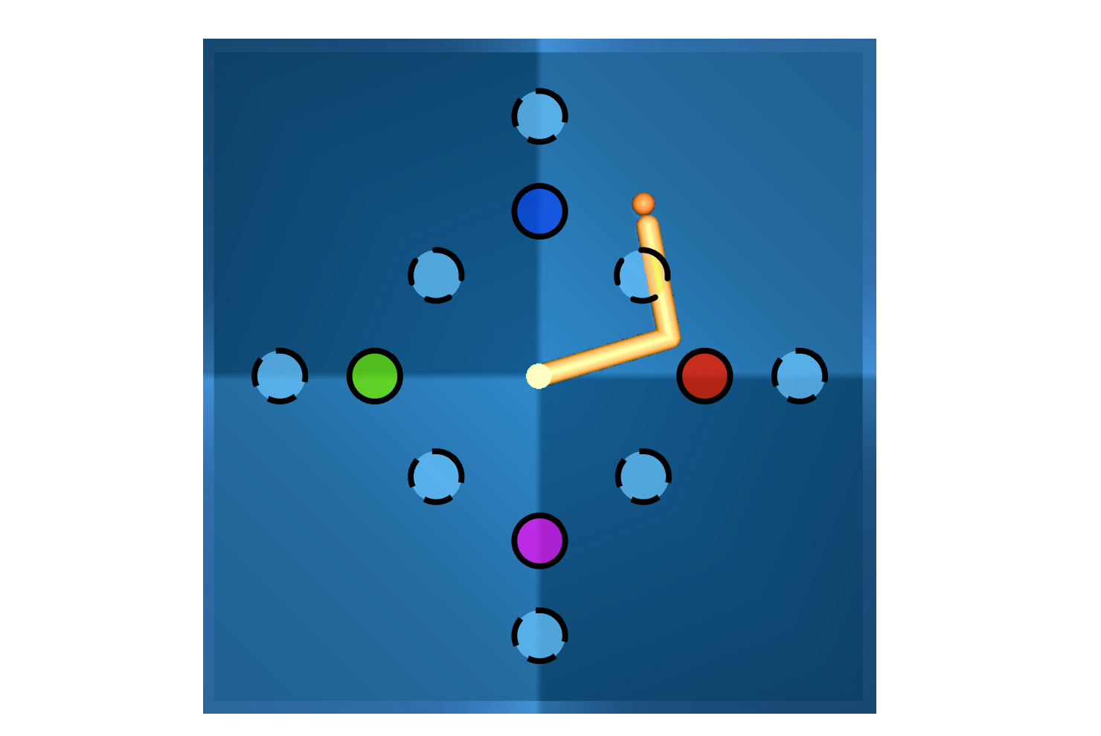
Experiments
$$φ(s)=\left[\begin{matrix}−{\left\|p−t_{1}\right\|}_{2} \\ −{\left\|p−t_{2}\right\|}_{2} \\ ⋮ \\ −{\left\|p−t_{n}\right\|}_{2}\end{matrix}\right]$$
$r_{i}(s)=$ $−{\left\|p−t_{i}\right\|}_{2}$
$$p$$
$$t_{i}$$

Slide 101
Experiments
Train on 4 tasks i.e. develop 4 skills
$${\tilde{ψ}}^{π_{1}}(s,a)$$
$${\tilde{ψ}}^{π_{2}}(s,a)$$
$${\tilde{ψ}}^{π_{3}}(s,a)$$
$${\tilde{ψ}}^{π_{4}}(s,a)$$
MLP1
MLP2
MLP3
MLP4
$$s$$
$$s$$
$$s$$
$$s$$
$$𝔼_{(s,a,s^{′})\sim D}\left[{\left(\tilde{φ}\left(s,a,s^{′}\right)+γ{\tilde{ψ}}^{π_{i}}(s^{′},a^{′})−{\tilde{ψ}}^{π_{i}}(s,a)\right)}^{2}\right]$$

Slide 102
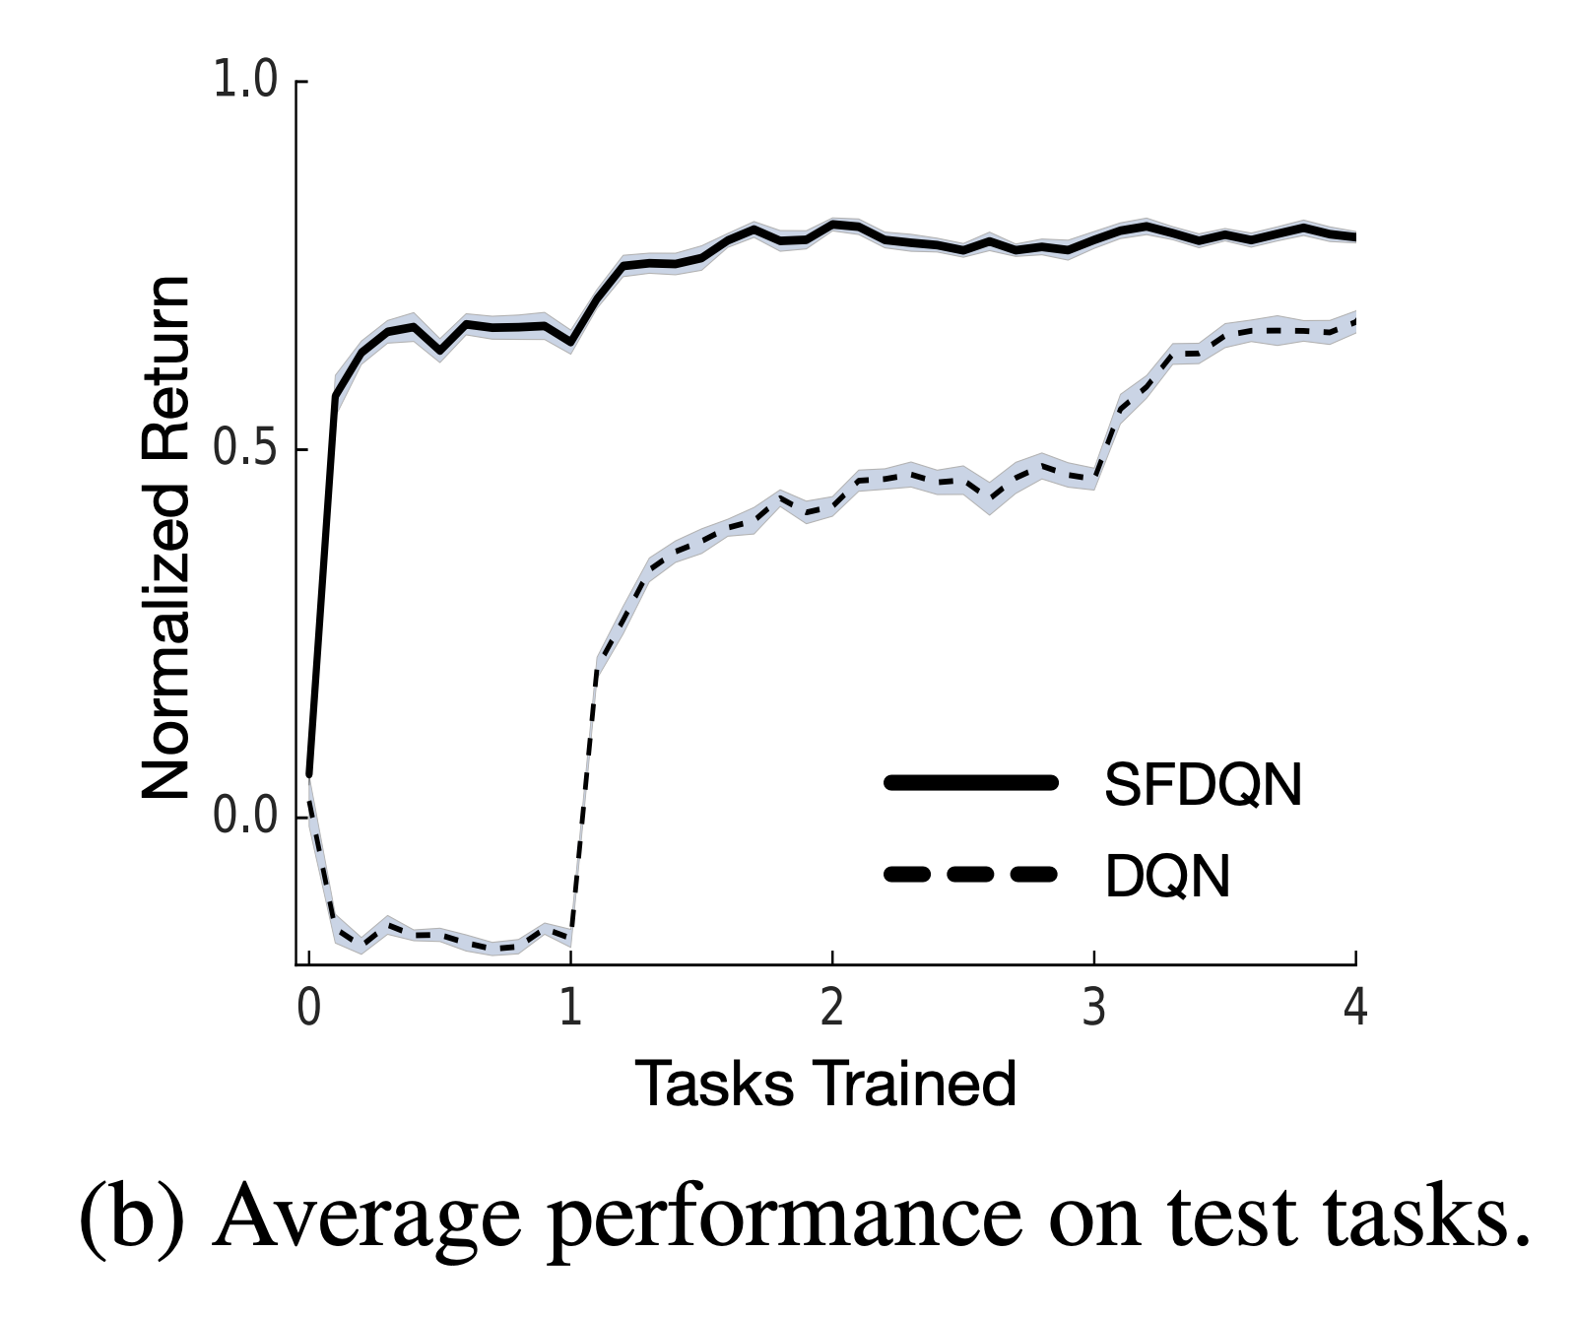
Experiments

Slide 103
Outlook
General Intelligence ?
“Intelligence measures an agent’s ability to achieve goals in a wide range of environments”
Shane Legg and Marcus Hutter. Universal Intelligence: A definition of machine intelligence. Minds and Machines, 2007

Slide 104
Questions

Slide 105
References
[1] Weber T. et. al. 2018. “Imagination Augmented-Agents for Deep Reinforcement Learning”.
[2] Barreto A. et. al. 2018. “Successor Features for Transfer in Reinforcement Learning”.
[3] Shane Legg and Marcus Hutter. “Universal Intelligence: A definition of machine intelligence”.

Slide 106
Appendix A: Imagination Augmented Agents

Slide 107
Environment Model Training
Optimized using negative log-likelihood
Pretrained from partially pre-trained model-free agent trajectories
Random agents would see few regions of reward…
Must account for budget of pre-training agent, and pretraining environment model.
$$o_{t}$$
$${\hat{o}}_{t+1}$$
$${\hat{r}}_{t+1}$$
$$ℒ_{env}=−\sum_{i∈I}{\sum_{c∈C}{⟦i∈c⟧}}\log{{\hat{o}}_{t+1}^{i,c}}$$

Slide 108
Monte Carlo Search Algorithm
Explicitly estimate value of each action from rollouts rather than learning an arbitrary encoding of the rollouts.
Learn $V$ from states
Use rollout policy $\hat{π}$ to sample trajectory rollout for each initial action.
Compute Monte Carlo return $\sum_{t≤T}{γ^{t}r_{t}^{a}+V(x_{T}^{a})}$
Action $a$ chosen with probability proportional to
$$\exp\left(−\left(\sum_{t≤T}{γ^{t}r_{t}^{a}+V(x_{T}^{a})}\right)/δ\right)$$

Slide 109
Experiments
Unroll Depth Analysis
Diminishing Returns
Choose 5 for speed
Even short rollouts can be highly informative !

Slide 110
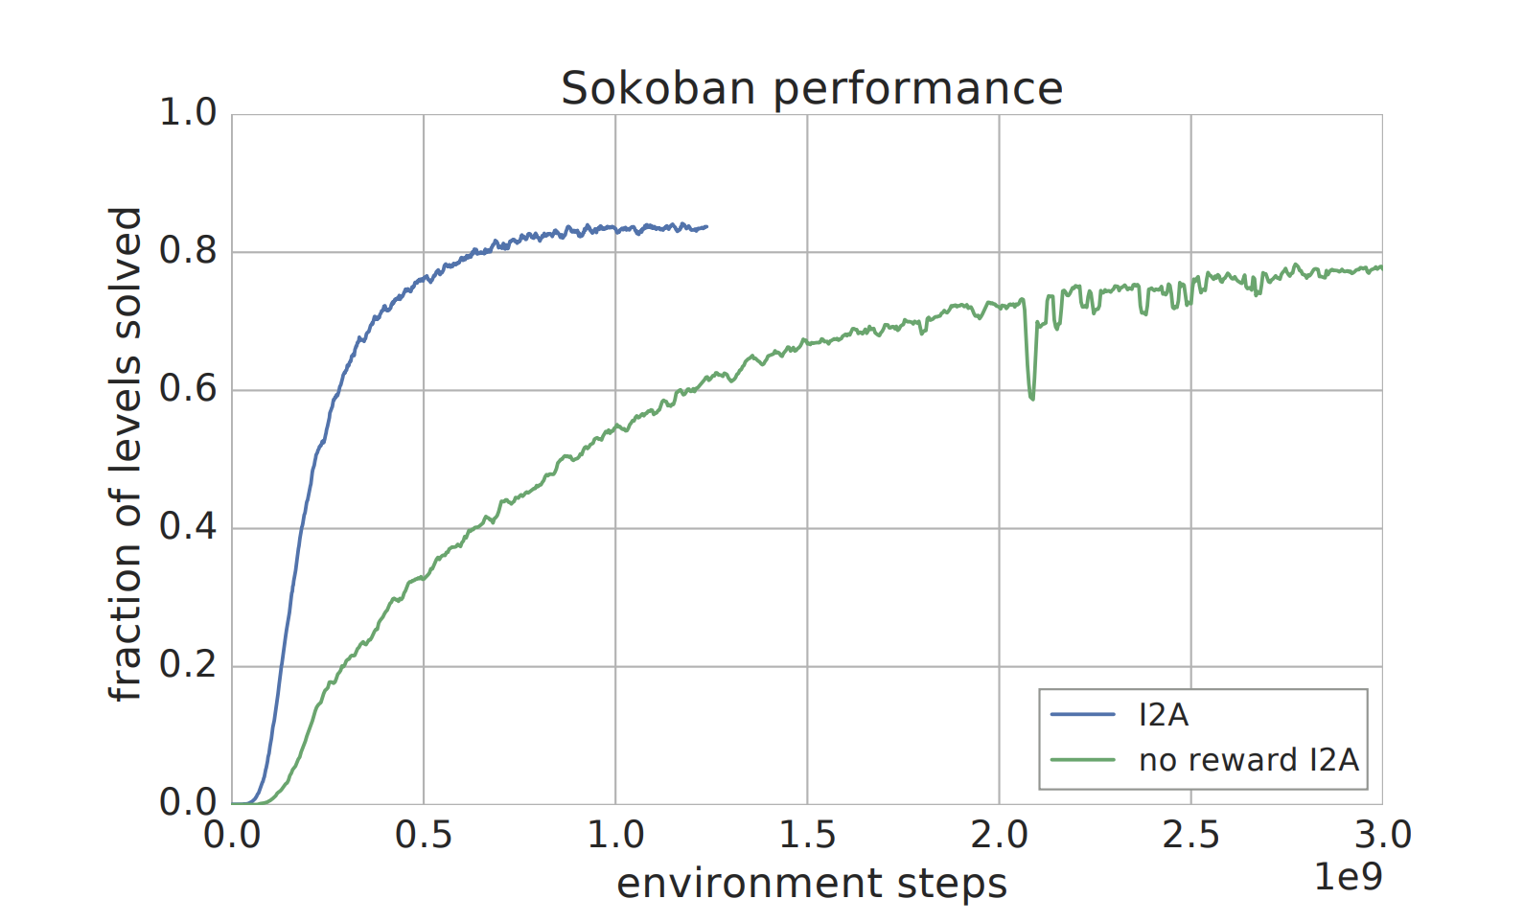
Experiments
I2A vs. Baselines
Rewards useful but not necessary

Slide 111
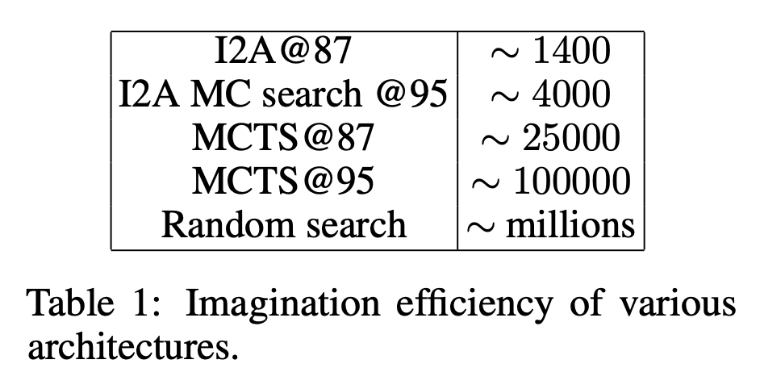
Experiments
Perfect Models
How does I2A compare to competitive planning methods using perfect model?
Imagination efficiency: “# imagination steps required to solve fixed ratio of levels”

Slide 112
Data Efficiency
Model Free RL maps values directly to actions
Requires a large amount of training data and resulting policies do not readily generalize to novel tasks in the same environment.
Model Based RL
Model must be learned first but can enable better generalization across states and remain valid across tasks in the same environment.
Scale performance with more computation by increasing the amount of internal simulation.

Slide 113
Data Efficiency
Environment model pretraining required 1e8 environment frames.
Considering pretraining, the I2A outperforms baselines after 3e8 frames
I2A was always less than an order of magnitude slower per interaction than the model-free baselines.
The amount of computation varies linearly with the length of the rollouts.

Slide 114
Related Work
Robotics – when transferring policies from simulation to the real world environment.
Paul Christiano et. al. “Transfer from simulation to real world through learning deep inverse dynamics model.” 2016
General idea of using internal recurrent models
Jürgen Schmidhuber. “On learning to think: Algorithmic information theory for novel combinations of reinforcement learning controllers and recurrent neural world models.” 2015

Slide 115
Appendix B: Successor Features for Transfer

Slide 116
Background and Problem Formulation
Markov Decision Process
$$ℳ≡(𝒮,𝒜,p,R,γ)$$
$p(⋅|s,a)$ dynamics
$R(s,a,s^{′})$ reward received upon transition
$r\left(s,a,s^{′}\right)=𝔼_{s^{′}\sim p(⋅|s,a)}[R\left(s,a,s^{′}\right)]$
Goal: maximize return
$$G_{t}=\sum_{i=0}^{∞}{γ^{i}R_{t+i+1}}$$

Slide 117
What is Transfer?
A policy $π^{′}$ learned on $ℳ^{′}$ for a new task $M_{n+1}$ induced by $w_{n+1}$ should perform worse than a policy $π$ learned on $ℳ$ where $ℳ^{′}⊂ℳ$
$$Q^{π}\left(s,a\right)≥Q^{π^{′}}(s,a)$$

Slide 118
What is Transfer?
Suppose $φ$ fixed, then each $w$ induces an MDP:
$$w_{task}$$

Slide 119
What is Transfer?
Suppose $φ$ fixed, then each $w$ induces an MDP:
$$w_{task}⟹r_{task}$$

Slide 120
What is Transfer?
Suppose $φ$ fixed, then each $w$ induces an MDP:
$$w_{task}⟹r_{task}=φ^{T}w_{task}$$

Slide 121
What is Transfer?
Suppose $φ$ fixed, then each $w$ induces an MDP:
$$w_{task}⟹r_{task}=φ^{T}w_{task}⟹ℳ^{φ}$$
$ℳ^{φ}$ the set of all MDPs induced by varying $w_{task}$

Slide 122
How does $ψ$ encode the dynamics ?
$ψ_{i}$ gives the expected discounted sum of the features $φ_{i}$.
If $φ$ is a one-hot vector of $𝒮×𝒜×𝒮,$ then $ψ$ is the discounted sum of occurrences of each possible transition

Slide 123
Stronger theoretical guarantees
In $ℳ^{φ}:$
$$Q_{i}^{π_{i}^{∗}}\left(s,a\right)−Q_{i}^{π}\left(s,a\right)≤\frac{2}{1−γ }\left(φ_{max}\min_{j}\left\|w_{i}−w_{j}\right\|+ε\right)$$
$$φ_{max}=\max_{s,a}{‖φ(s,a)‖}$$
Algorithmic choice: limit the number of ${\tilde{ψ}}^{π_{i}}$stored in memory. Create new ${\tilde{ψ}}^{π_{i}}$ only when $\min_{j}\left\|w_{i}−w_{j}\right\|$ is above a threshold.

Slide 124
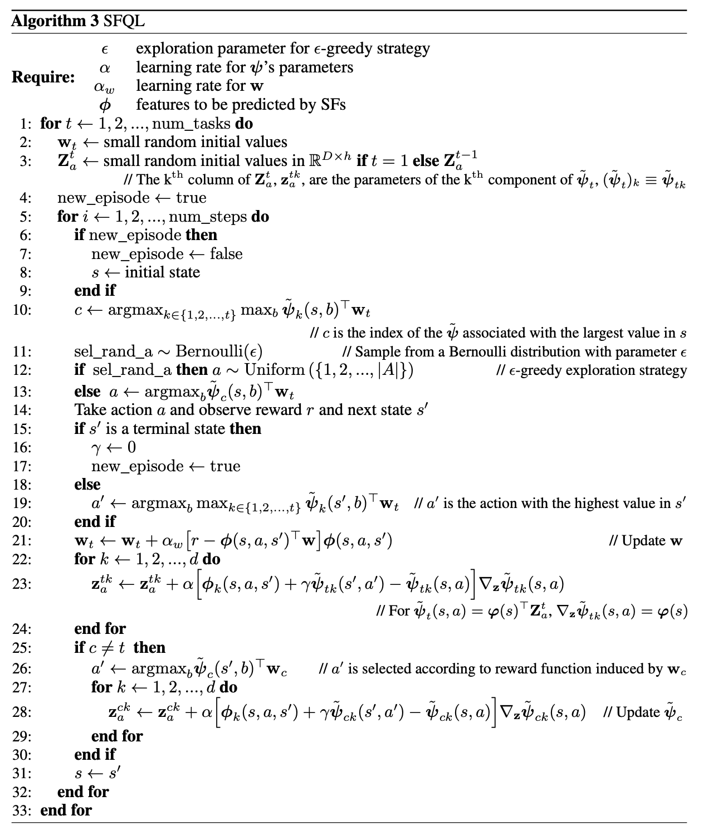
SFQL Algorithm

Slide 125
SFQL Algorithm

Slide 126
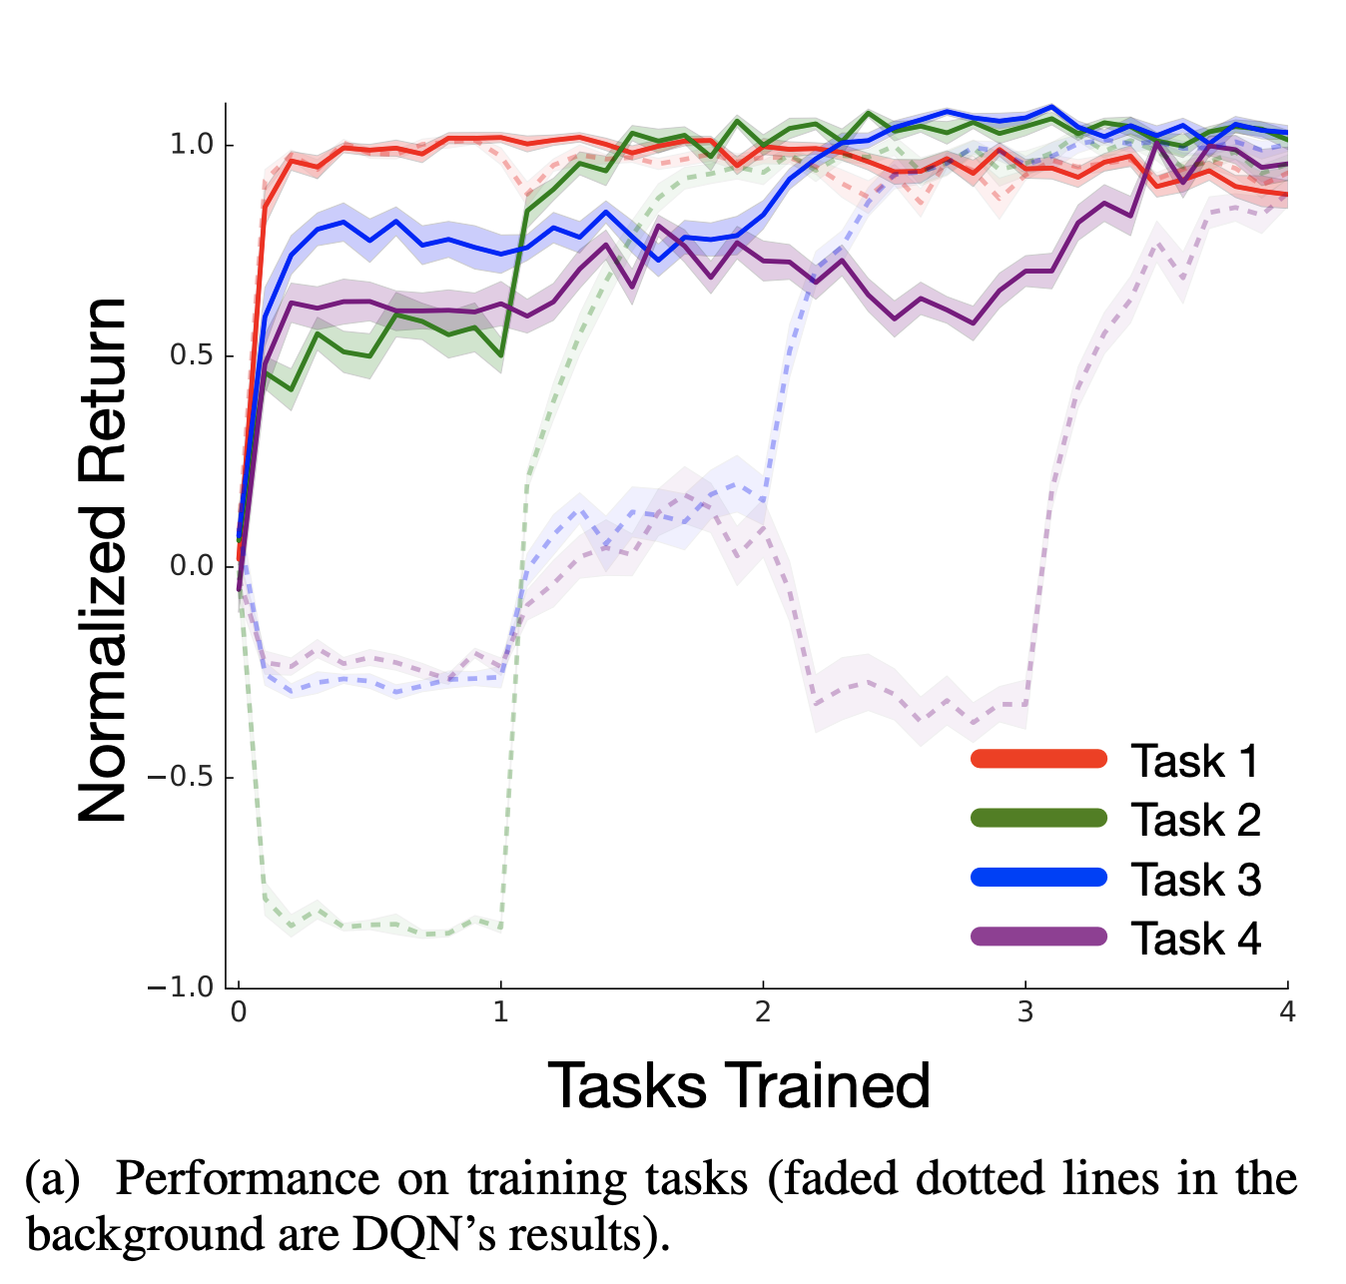
Experiments

