Slide 1
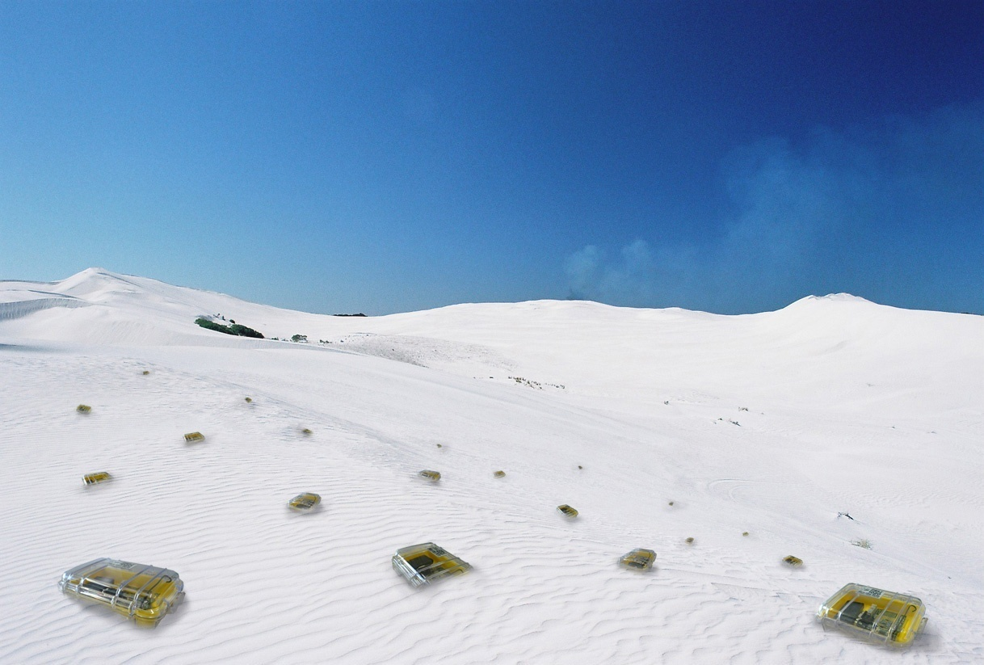

Routing
Chapter 11
TexPoint fonts used in EMF.
Read the TexPoint manual before you delete this box.: AAAAA

Slide 2
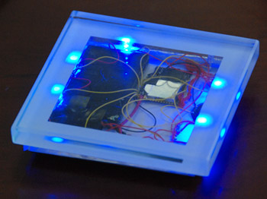
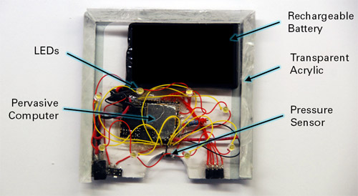
Application of the Week: Games / Art
Uncountable possibilities, below, e.g., a beer coaster that can interact with other coasters…
[sentilla]

Slide 3
Rating
Area maturity
Practical importance
Theory appeal
First steps Text book
routing is so overrated...
No apps Mission critical
Boooooooring Exciting

Slide 4
Overview
Characteristics and models
10 tricks for classic routing
Selected case studies
  Link reversal routing
  Geo-routing without geometry
  Greedy routing
  Compact routing

Slide 5
Network Layer Services
Unicast (send message to a given node)
Multicast (send message to a given set of nodes)

Slide 6
Network Layer Services (2)
Anycast (send message to any node of a given set)
More
  Broadcast (special form of multicast, to everybody)
  Convergecast (data gathering, reverse of broadcast)
  Geocast (routing to a specific location)
  …

Slide 7
Remember: Discussion of Classic Routing Protocols
Proactive Routing Protocols
Both link-state and distance vector are “proactive,” that is, routes are established and updated even if they are never needed.
If there is almost no mobility, proactive algorithms are superior because they never have to exchange information and find optimal routes easily.
Reactive Routing Protocols
Flooding is “reactive,” but does not scale
If mobility is high and data transmission rare, reactive algorithms are superior; in the extreme case of almost no data and very much mobility the simple flooding protocol might be a good choice.
There is no “optimal” routing protocol; the choice of the routing protocol depends on the circumstances. Of particular importance is the mobility/data ratio.

Slide 8
Routing in Ad-Hoc Networks
Reliability
  Nodes in an ad-hoc network are not 100% reliable
  Algorithms need to find alternate routes when nodes are failing
Mobile Ad-Hoc Network (MANET)
  It is often assumed that the nodes are mobile (“Car2Car”)
10 Tricks → 2¹⁰ routing algorithms
Let’s see some of these classic tricks…

Slide 9
Radius Growth
Problem of flooding (and protocols using flooding): The destination is two hops away, but we flood the whole network
Idea: Flood with growing radius; use time-to-live (TTL) tag that is decreased at every node, for the first flood initialize TTL with 1, then 2, then 4 (really?),
  How do we stop once the destination is found?
Alternative idea: Flood very slowly (nodes wait some time before they forward the message) – when the destination is found, it initiates a fast flood that stops the slow flood
+ Tradeoff time vs. number of messages

Slide 10
Source Routing
Problem: Why should nodes store routing information for others?
Idea: Source node stores the whole path to the destination; source stores path with every message, so nodes on the path simply chop off themselves and send the message to the next node.
“Dynamic Source Routing” discovers a new path with flooding (message stores history, if it arrives at the destination it is sent back to the source through the same path)
+ Nodes only store the paths that they need
– Not efficient if mobility/data ratio is high
– Asymmetric Links?

Slide 11
Asymmetric Links
Problem: The destination cannot send the newly found path to the source because at least one of the links used was unidirectional.
Idea: The destination needs to find the source by flooding again, the path is attached to the flooded message. The destination has information about the source (approximate distance, maybe even direction), which can be used.
In theory, if stations are
homogeneous, the received
signal strength should be equal.
  However, noise and interference
  experienced might differ.
  How can we figure out whether an asymmetric link is vital?
s
c
b
a
t

Slide 12
Re-use/cache routes
This idea comes in many flavors
  Clearly a source s that has already found a route “s-a-b-c-t” does not need to flood again in order to find a route to node c.
  Also, if node u receives a flooding message that searches for node v, and node u knows how to reach v, u might answer to the flooding initiator directly.
  If node u sees a message with a path (through u), node u will learn (cache) this path for future use.
+ Without caching you might do the same work twice
– Which information is up-to-date? Sequence numbers for updates
– Caching is somewhat in contradiction to the source routing philosophy, because you start building routing tables again

Slide 13
Local search
Problem: When trying to forward a message on path “s-a-u-c-t” node u recognizes that node c is not a neighbor anymore.
Idea: Instead of not delivering the message and sending a NAK to s, node u could try to search for t itself; maybe even by flooding.
  Some algorithms hope that node t is still within the same distance as before, so they can do a flooding with TTL being set to the original distance (plus one)
  If u does not find t, maybe the predecessor of u (e.g., node a) does?
– Sometimes this works, sometimes not.

Slide 14
Hierarchy
Problem: Especially proactive algorithms do not scale with the number of nodes. Each node needs to store big tables
Idea: In the Internet there is a hierarchy of nodes; i.e. all nodes with the same IP prefix are in the same direction. One could do the same trick in ad hoc networks
+ Well, if it happens that ad hoc nodes with the same numbers are in the same area, hierarchical routing is a good idea. In static networks this is a good idea, and indeed we’ll see an example of that later.
– In MANETs this is a problem…

Slide 15
More concretely: Clustering
Idea: Group the ad hoc nodes into clusters (even hierarchically). One node is the head of the cluster. If a node in the cluster sends a message it sends it to the head which sends it to the head of the destination cluster which sends it to the destination
+ Simplifies operation for most nodes
(that are not cluster heads); this is
particularly useful if the nodes are
heterogeneous and the cluster
heads are “stronger” than others.
– A level of indirection adds overhead.
– There will be more contention at
the cluster heads, but this might
be solved by re-computing the
cluster heads from time to time, or
by computing domatic partitions…
Internet
cluster
super cluster

Slide 16
Implicit Acknowledgement
Problem: Node u only knows that neighbor node v has received a message if node v sends an acknowledgement.
Idea: If v is not the destination, v needs to forward the message to the next node w on the path. If links are symmetric (and they need to be in order to send acknowledgements anyway), node u will automatically hear the transmission from v to w (unless node u has interference with another message).
Can we set up the MAC layer such that interference is impossible?

Slide 17
Smarter updates
Sequence numbers for all routing updates
+ Avoids loops and inconsistencies
+ Assures in-order execution of all updates
Decrease of update frequency
Store time between first and best announcement of a path
Inhibit update if it seems to be unstable (based on the stored time values)
+ Less traffic
Implemented in Destination Sequenced Distance Vector (DSDV)

Slide 18
Use other distance metrics
Problem: The number of hops is fine for the Internet, but for ad hoc networks alternative quality measures might be better, e.g., energy, congestion, successful transmission probability, interference*, etc.
  Some of these measures may be multiplicative
  It‘s not clear how to
  compute some of
  these measures,
  e.g. interference,
  in a MANET.
  *Interference:
  Use one of the
  definitions seen
  in the Chapter on
  Capacity
N₁
N₂
R₁
S₁
N₃
N₄
N₅
N₆
R₂
S₂
N₈
N₉
N₇

Slide 19
Selfishness
Problem: Why should nodes forward messages for others?
Two ideas: Recursively encrypt source routing messages by means of public key cryptography, so that each node on the path can only see whether it is the next hop. In addition don’t use optimal routing paths, instead add a little “noose” to the end of each path.
This way each intermediate node on the path might worry that it is actually the destination itself, and hence each intermediate node has an incentive to forward messages.
+ This protocol is indeed incentive-compatible (in contrast to many others which only claim to be incentive-compatible)
– The overhead might be high
– More about forwarding than about routing

Slide 20
Case Study: Link Reversal Routing
An interesting proactive routing protocol with low overhead.
Idea: For each destination, all communication links are directed, such that following the arrows always brings you to the destination.
Example with only one destination D, i.e. sink in a sensor network:
Note that positive labels can be chosen such that higher
labels point to lower labels (destination label D = 0).
6
9
11
5
7
13
1
D
17
3
8
12
4

Slide 21
Link Reversal Routing: Mobility
Links may fail/disappear: if nodes still have outlinks → no problem!
New links may emerge: just insert them such that there are no loops
  Use the labels to figure out link direction
6
9
11
5
X
7
X
13
1
D
X
17
3
8
12
4

Slide 22
Link Reversal Routing: Mobility
Only problem: Non-destination becomes a sink → reverse all links!
  Not shown in example: If you reverse all links, then increase label.
  Recursive progress can be quite tedious… How tedious?!?
6
9
11
5
7
X
X
13
1
D
17
3
8
12
4

Slide 23
Link Reversal Routing: Analysis
In a ring network with n nodes, a deletion of a single link (close to the sink) makes the algorithm reverse like crazy: Indeed a single link failure may start a reversal process that takes n rounds, and n links reverse themselves n² times!
That’s why some researchers proposed partial link reversal, where nodes only reverse links that were not reversed before.
However, it was shown by Busch et al. that in the extreme case also partial link reversal is not efficient, it may in fact even worse be than regular link reversal.
Still, some protocols (TORA) are based on link reversal.

Slide 24
Case Study: Geo-Routing without Geometry
For many applications, like routing, finding a realization of a UDG is not mandatory
Virtual coordinates merely as infrastructure for geometric routing
→ Pseudo geometric coordinates:
  Select some nodes as anchors: a₁,a₂, ..., a_{k}
  Coordinate of each node u is its hop-distance to all anchors: (d(u,a₁),d(u,a₂),..., d(u,a_{k}))
Requirements:
  each node uniquely identified: Naming Problem
  routing based on (pseudo geometric) coordinates
  possible: Routing Problem
(0)
(1)
(2)
(3)
(4)

Slide 25
Pseudo-geo-routing on the grid: Naming
Anchor 1
(4)
Anchor 2
(4,2)
(4)
(4,4)
(4)
(4,6)
(4)
(4,8)
(4)
The naming problem in the grid can be solved with two anchors.
(4,10)

Slide 26
Pseudo-geo-routing on the grid: Routing
Anchor 1
Anchor 2
Rule: pass message to neighbor which is closest to destination.
(5,5)
(6,4)
(3,9)
(4,8)
(5,7)
(6,6)
(4,10)
(5,9)
(6,8)
(7,7)
(5,11)
(6,10)
(7,9)
The routing problem in the grid can be solved with two anchors.

Slide 27
Problem: Even a UDG is not a grid
But even subgraphs of a grid
(which are realistic) might
have trouble to work with
few anchors only.
E.g., recursive construction
of a unit disk tree (UDT,
UDG which is a tree)
which needs Ω(n) anchors
k

Slide 28
Pseudo-geo-routing in the UDT: Naming
Leaf-siblings can only be distinguished if one of them is an anchor:
Anchor 1..Anchor k
(a,b,c,...)
(a+1,b+1,c+1,...)
(a+1,b+1,c+1,...)
Anchor k+1
In a unit disk tree with n nodes there are up to Θ(n) leaf-siblings. That is, we need Θ(n) anchors.

Slide 29
Pseudo-geo-routing in ad hoc networks
Naming and routing in grid quite good, in previous UDT example very bad
Real-world ad hoc networks are very probable neither perfect grids nor naughty unit disk trees
Truth is somewhere in between...

Slide 30
Case Study: Greedy Routing
Idea: Give nodes (virtual) coordinates such that one can simply routing greedily towards the destination, for any destination.
In other words, always send the message to the neighbor with the best coordinates, closest to the destination coordinates. One may call this routing without routers (or routing tables).
What is needed first is to embed the network into some high-dimensional Euclidean space, such that greedy routing between any pairs of nodes is possible.
Is this always possible?
What dimension of Euclidean space do we need?

Slide 31
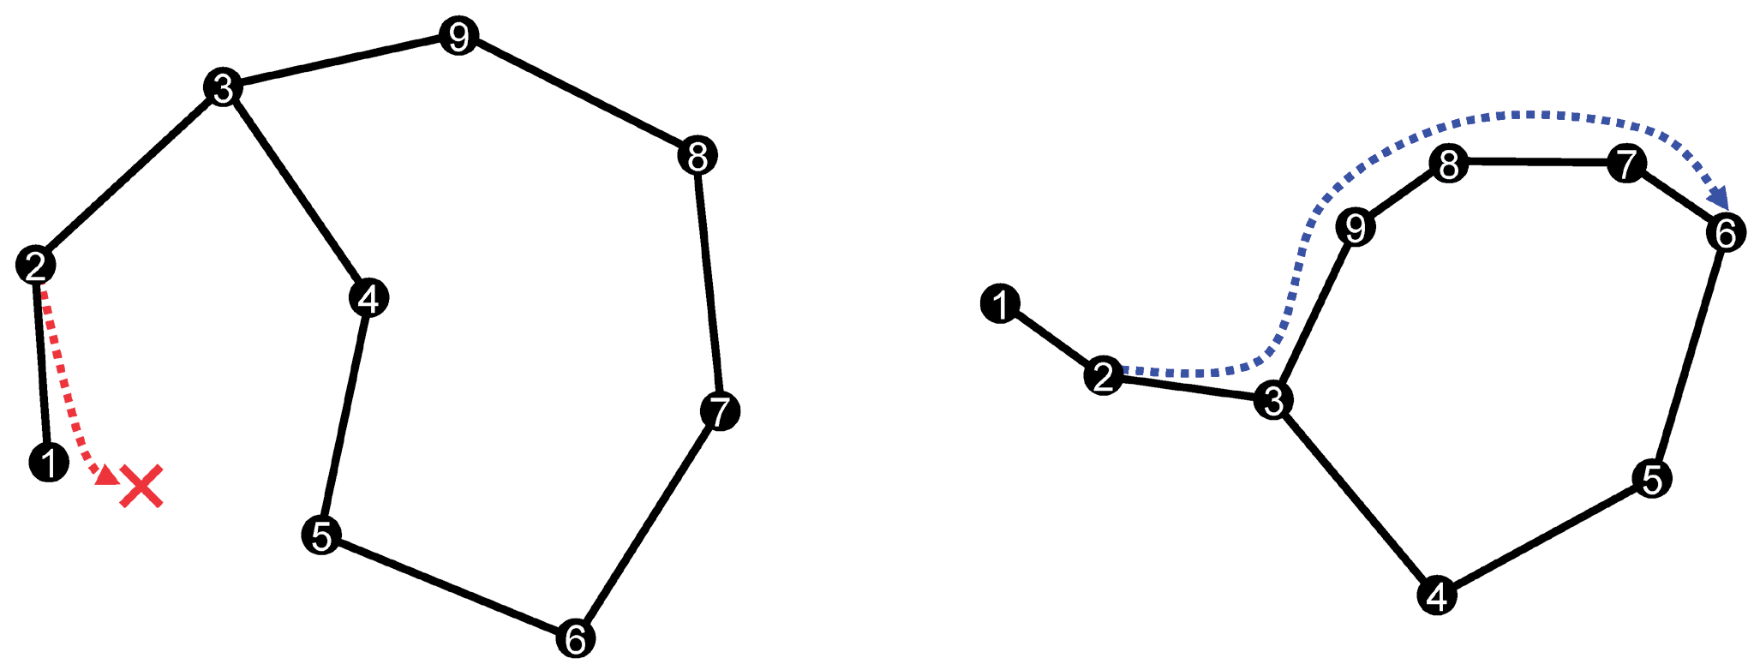
Greedy Routing: Example
The figure below shows two embeddings of the same network into 2D space.
The left embedding is not a greedy embedding. When routing from node 2 to node 6 one will end up in a deadlock at node 1.
The right embedding is greedy, however, routes may experience a stretch.

Slide 32
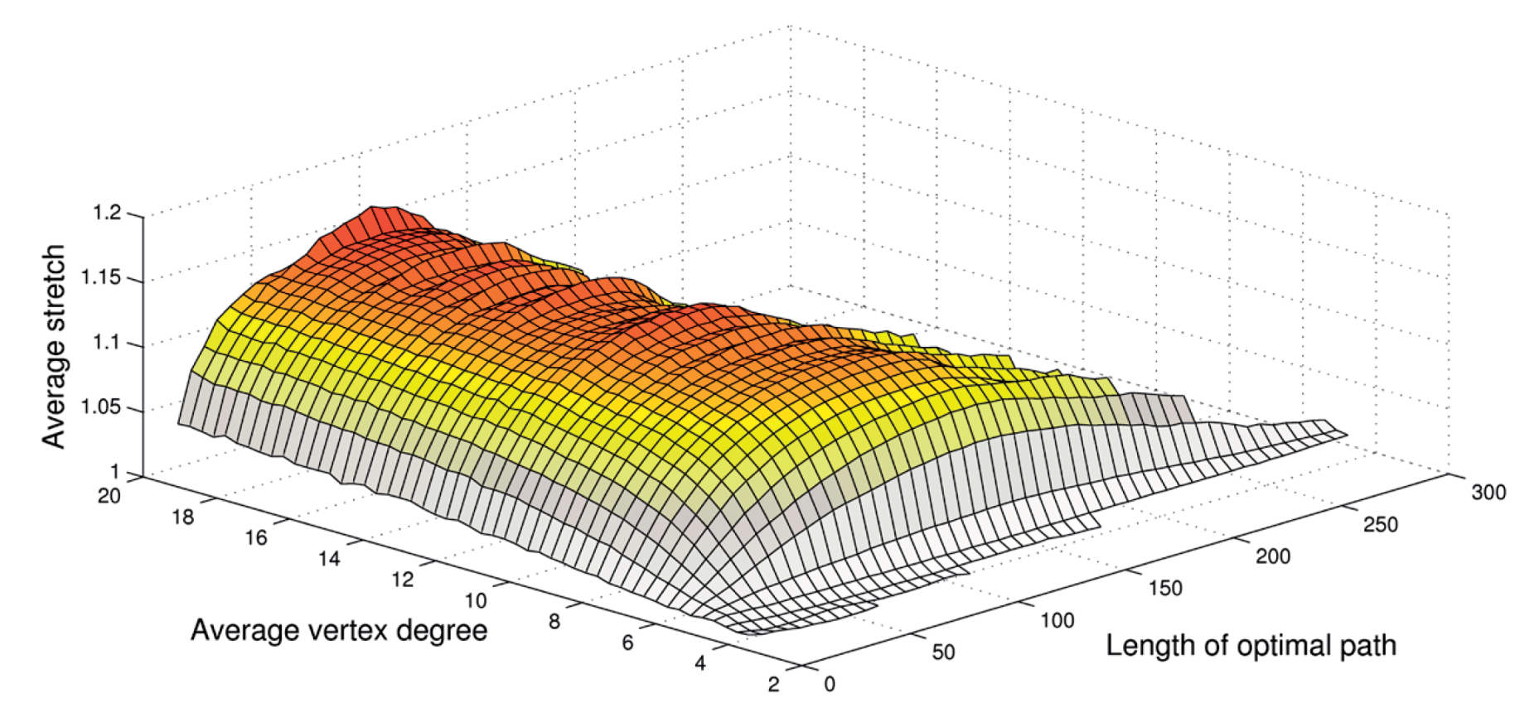
Greedy Routing: Some Results
One can show that greedy routing is always possible. Using a polylog-dimensional virtual coordinate space, one can bound the stretch by a constant factor (for unit disk graphs), and by a logarithm (for general graphs). In practice, the stretch is better:

Slide 33
Case Study: Compact Routing
Generally, there are too many aspects/tradeoffs. Some of these tradeoffs are quite well understood in theory, others not at all.
A trade-off which is well understood is known as compact routing:
Remember: The stretch is the ratio of the route length divided by the length of the shortest path, over all routes
For general (static) graphs it was shown that a stretch strictly below 3 cannot be achieved unless routing tables are at least linear in the number of nodes (in the worst case).
So what about more realistic graphs (BIG, UBG, etc.)?!?
Routing Table Size vs. Routing Stretch

Slide 34
Reminder: Constant Doubling Metric
Metric (V,d) with constant doubling dimension
  Metric: distances between all pairs, non-negative, triangle inequality
  Ball B_{u}(r) := { v | v 2 V and dist(u, v) · r }
  Doubling dimension ® = log(#balls of radius r/2 to cover ball of radius r)
  ® is constant

Slide 35
What can be achieved?
Labeled routing scheme → nodes can choose an ID
(1+ε)-approximation for Unicast Routing
Constant approximations for Multicast and Anycast
Label size: O(α log D) (bits)
  D is the diameter of the network
Routing table size: O(1/ε)^{α} (log D) (O(α) + log Δ) (bits)
  α is the doubling dimension of the graph (small constant, 3-5)
  Δ is the max degree of any node
There are so-called name-independent compact routing algorithms which can almost achieve the same bounds as their labeled counterparts by adding a “peer-to-peer” technique.

Slide 36
Node Labeling: ρ-net
Given a graph G=(V,E)
U ½ V is a ρ-net if
  a) 8 v 2 V: 9 u 2 U : d(u,v) · ρ
  b) 8 u₁, u₂ 2 U : d(u₁, u₂) > ρ
Net centers of the ρ-net

Slide 37
Dominance Net Hierarchy
Build ρ-nets for ρ 2 {1, 2, 4, …, 2^{d log De} }
Level 3
ρ = 8
Level 2
ρ = 4
Level 1
ρ = 2
Level 0
ρ = 1

Slide 38
Naming Scheme
Select parent from next higher level
Parent enumerates all of its children
  At most 2^{2α} children
  2α bits are sufficient for the enumeration
Name of net-center obtained by concatenation of enum values
  Name at most 2α log D bits long
Root
1
2
3
4
5
6
1
1
1
1
2
1
2
1
2
3
R:6:3:2
1
2
1
1
2
1
2
1
2
3
1
1
2
1
1
2

Slide 39
Node Labeling
Each net-center c of a ρ-net advertises itself to B_{c}(2ρ)
Any node u stores ID of all net-centers from which it receives advertisements
  Per level at most 2^{2α} net-centers to store
  If net-center c covers u, then also the parent of c covers u
  The set of net-centers to store form a tree
  Per level at most 2^{2α} ¢ 2α bits
  d log De levels
  With ¢ neighbors, the next hop can be determined with log ¢ bits.
  ) For a constant α an the routing table size at each node is O(log ¢¢log D)
Level 3
1
2
3
4
5
6
Level 2
Level 1
1
1
1
1
2
1
2
1
2
3
1
2
1
1
2
1
2
1
2
3
1
1
2
1
1
2
Level 0
u

Slide 40
Unicast Routing
Problem: From a sender node s, send a message to a target node t, given the ID and label L(t).
Algorithm: From all net-centers listed in L(t), s picks the net-center c on the lowest level to which it has routing information and forwards the message towards c.
Idea: Once we reach a first net-center of t, we are sure to find a closer net-center on a lower layer.
The path to the first net-center causes only little overhead as the net-centers advertise themselves quite far.
c₁
s
t
c₂
c₃

Slide 41
A more detailed analysis
Routing tables to support (1+ε) stretch routing
  Recall: Routing table size of O(1/ε)^{α} (log D) (O(α) + log Δ) bits
Every net-center c 2 ρ-net of the dominance net advertises itself to B_{c}(ρ (8/ε + 6))
Every node stores direction to reach all advertising net-centers
c
B_{c}(ρ (8/ε + 6))

Slide 42
A more detailed analysis (2)
Each node needs to store direction for at most 2^{2α}(8/ε + 6)^{α} net-centers per level
If a node needs to store a routing entry for net-center c, then it also needs to store a routing entry for the parent of c.
  Again, the routing table can be stored as a tree
For each net-center, we need to store its enumeration value, and the next-hop information, which takes at most 2α + log Δ bits
Total storage cost is 2^{2α}(8/ε + 6)^{α} log D (2α + log Δ) bits.
Similar bounds hold for multicast and anycast.

Slide 43
Open Problem
Apart from compact routing, almost nothing “interesting” is known in the routing domain. From a theoretical point of view, classic ad hoc routing protocols such as AODV or DSR perform very poorly.
An interesting open question is whether a provably efficient routing algorithm for MANETs (truly dynamic) can be constructed.
Mind however that one has to carefully argue around too simple cooked-up worst-case examples (e.g. messages may be stuck on “mobile islands”).

