Slide 1
Computer Systems
Week 11

Slide 2
Last exercise
Quorums: 7 Work: 3 Load: 3/7

Slide 3
Last exercise
Quorums: 7 Work: 3 Load: 3/7
Resilience: 2, because every
node is in 3 quorums, so two
nodes can be contained in at most 2*3 quorums

Slide 4
Last exercise

Slide 5
Last exercise
Idea: No matter which quorum gets accessed, exactly s nodes have to work. Therefore the sum of all loads should sum up to s (sum of access probabilities must sum to s if s always gets accessed). To minimize the maximum element of a sum, set all elements to the average (balanced access strategy).

Slide 6
Last exercise

Slide 7
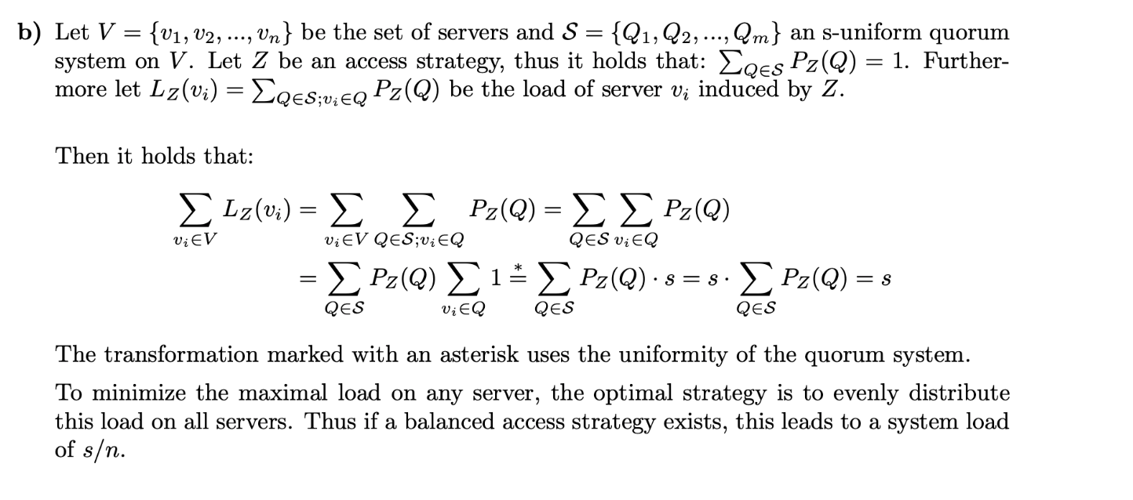
Last exercise

Slide 8
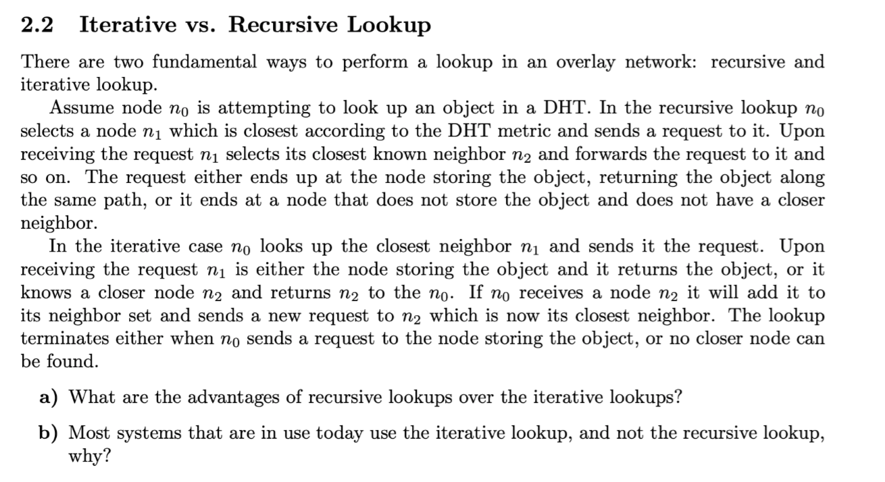
Last exercise
-same logic can be used for a node sending a request and forwarding a request. The result will always be passed back to the last node
-results can be hashed on the way back and speed up further requests
b) Denial of service attacks are easier with recursive lookups since more hops are involved and the attacker can “hide” his identity to victim.

Slide 9
Last exercise
Salted hashing is easier to compute.

Slide 10
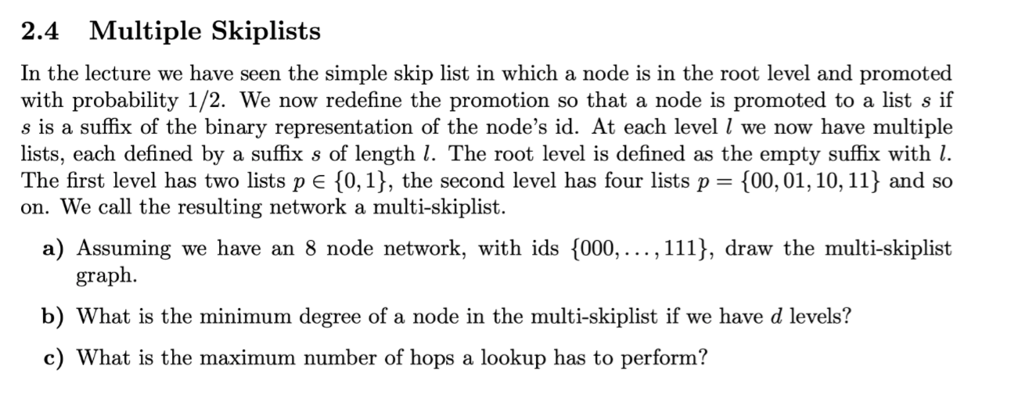
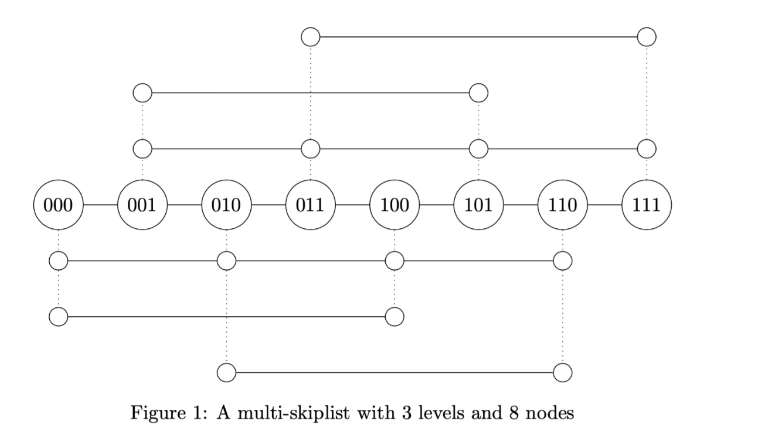
Last exercise

Slide 11
Consistency, Availability,
and Partition Tolerance
Consistency:
All nodes agree on the current state of the system
Availability:
The system is operational and instantly processing incoming requests
Partition tolerance:
Still works correctly if a network partition happens
Good news:
achieving any two is very easy
Bad news:
achieving three is impossible (CAP theorem)
=> Eventual Consistency:
Guarantees that the state is eventually agreed upon, but the nodes may disagree temprorarily

Slide 12
Bitcoin
decentralized network consisting of nodes
users generate private/public key pair
address is generated from public key
it is difficult to get users “real” identity from public key
6
signature a
5
signature a
Inputs
Outputs
4
signature b
3
signature b
1signature a
Transaction

Slide 13
Bitcoin Transactions
Conditions:
Sum of inputs must always be at least the sum of outputs
unused part is used as transaction fee, gets paid to miner of block
An input must always be some whole output, no splitting allowed!
Money that a user “has” is defined as sum of unspent outputs

Slide 14
Bitcoin Transactions
(A, 100)
(C, 105)
(A, 5)
(B, 100)
(A, 10)
Set of unspent transaction outputs (UTXOs):
- This set is the shared state of Bitcoin
- The red outputs
(B, 90)

Slide 15
Transaction Broadcast
1. issue transaction
3. send transaction to other nodes in network
2. add transaction to local history
4. check whether transaction is valid
input of transaction must be in local UTXO
must have valid signature
sum of inputs >= sum of outputs
5. remove any input of transaction from local UTXO
6. add transaction to local history
7. propagate transaction further

Slide 16
Doublespend Attack
Multiple transactions attempt to spend the same output
Ex: In a transaction, an attacker pretends to transfer an output to a victim, only to doublespend the same amount in another transaction back to itself.
Broadcast
(B, 100)
(A, 100)
Broadcast
(B, 100)
(B, 100)

Slide 17
Proof-of-Work
Right now we have infinitely growing memory pool and we can’t be sure that other nodes have the same pool
Solution: Propagate memory pool through network and make sure everybody else will have same state
Problem: How to avoid that everybody wants to propagate it’s own memory pool?
Solution: Proof-of-Work
proof that you put a certain amount of work into propagating your memory pool

Slide 18
Proof-of-Work
Bitcoin chooses the difficulty such that a block is created all ~10 min
Bitcoin PoW:

Slide 19
Block
Data structure holding transactions reference to previous blocks and a nonce.
Miner creates blocks with transactions from the memory pool
Hash(previous)
Hash(previous)
Hash(previous)
T1
T1
T1
T2
T2
T2
…
…
…
Finding this Nonce is expensive
Tn
Tn
Tn
nonce
nonce
nonce
Hash(this)
Hash(this)
Hash(this)

Slide 20
Mining
Why should someone mine blocks?
You get a reward for each block you mine
You get the fee in the transactions
Bitcoin:
Reward started at 50B and it is being halved every 210,000 blocks or 4 years in expectation
This bounds the total number of Bitcoins to 21 million
What will happen after that?
Fee is the positive difference of input-output
Problem: Miner go for transactions which have a high fee.
Problem: More miners -> more blocks are mined -> higher difficulty -> more Power needed

Slide 21
How does this prevent
double spending?
An intruder needs to have 50% of computation power to be faster in mining than all other together
The goal of Alice is now to make the branch where she spends the money to herself growing faster.
A -> A:
10
doublespend
A -> B: 10

Slide 22
Blockchain
Starts with the genesis block and is the longest path from this genesis block to a leaf.
Consistent transaction history on which all nodes eventually agree
A -> A:
10
Blockchain
Genesis
A -> B: 10
…
Note: To ensure that you’ll get the money you should wait 5-10 further blocks

Slide 23
Smart Contracts
Contract between two or more parties, encoded in such a way that correct execution is guaranteed by blockchain
Timelock: transaction will only get added to memory pool after some time has expired
Micropayment channel:
Idea: Two parties want to do multiple small transactions, but want to avoid fees. So they only submit first and last transaction to blockchain and privately do everything inbetween

Slide 24
Micropayment Channel
Setup Transaction
A
B
cannot do anything with this,
since no transaction has
all required signatures
1) creates shared “account”, does not sign it
2) creates timelocked transaction that unrolls
shared account, signs it
3) sends them to B
can’t do anything with this, since unroll
transaction is not valid without create
transaction
4) signs both transactions
5) signs create transaction
6) broadcasts them to network

Slide 25
Micropayment Channel
set up shared account and unrolling
create settlement transaction
while buyer still has money and timelock not expired
exchange goods and adapt money
update settlement transactions with new values
S signs transaction and sends it to R
R signs last transaction and broadcasts it
before timelock expires
Why does s sign it?
like this, R always holds all fully signed transactions and can choose the last one (where he gets the most money)
S cannot submit any transaction, so S cannot get the goods and later submit a transaction where S did not pay
the money for it

Slide 26
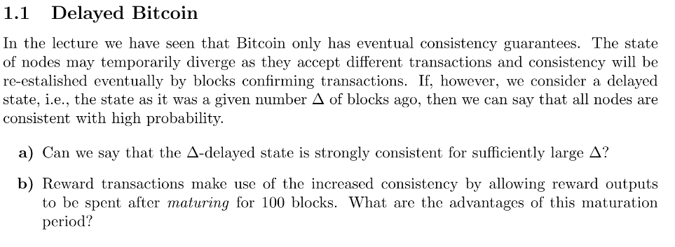
Quiz

Slide 27
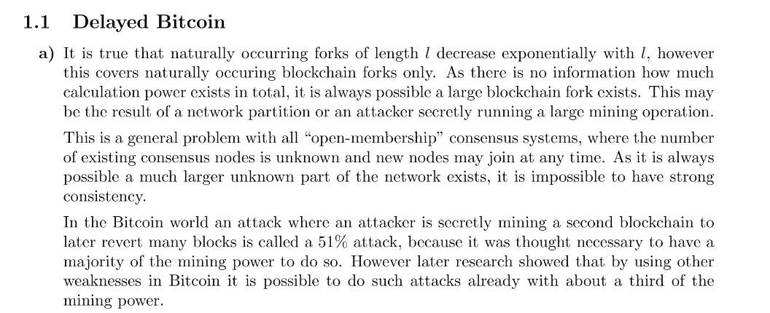

Slide 28
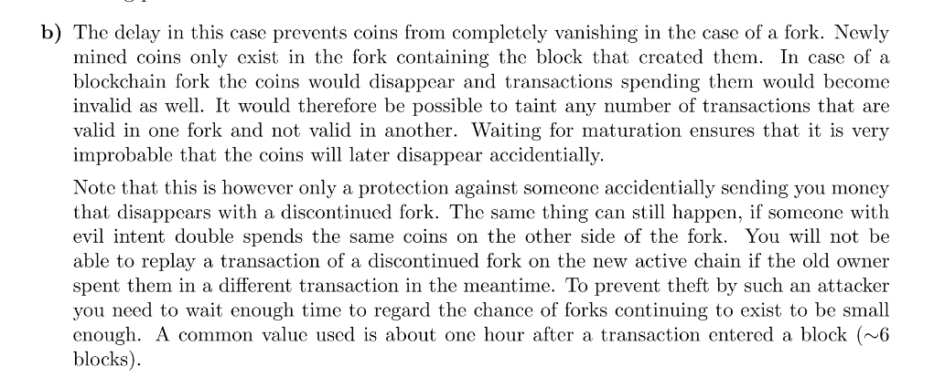

Slide 29
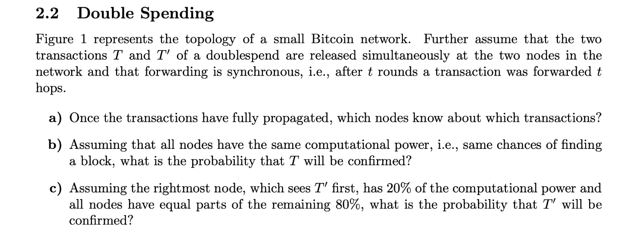
Quiz

Slide 30
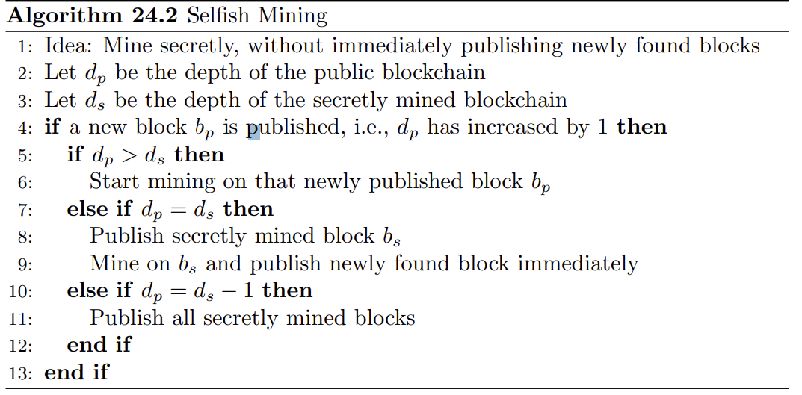
Selfish Mining

Slide 31
Selfish Mining
𝜷 is prob. others find block
𝜶 is prob. Selfish miner finds block
𝜶
Selfish miner does not release its block immediately, but keeps secret and works on “grandchildren” (secret)
𝜷
𝜶
Advantage: selfish miner can work on next-next block, while others still work on next block. Releasing gives reward for two blocks
d_p
d_s
Disadvantage : Work on grandchildren rendered useless when public chain gets longer.

Slide 32
Selfish Mining
Selfish minor is two block ahead and new public block -> release all secret blocks

Slide 33
Share of reachable nodes if selfish miner publishes
Ratio of mining power

Slide 34
Ethereum DAG
What problem is the a DAG-blockchain trying to solve?
Get rid of wasted mining time on forks, wasted blocks that are never used
This is even more prevalent in Ethereum than bitcoin. Why?
Smaller interval in mining time results in more childless blocks, “uncles”.
What problem do we need to solve to use a DAG as a blockchain
We need a total ordering of blocks.

Slide 35
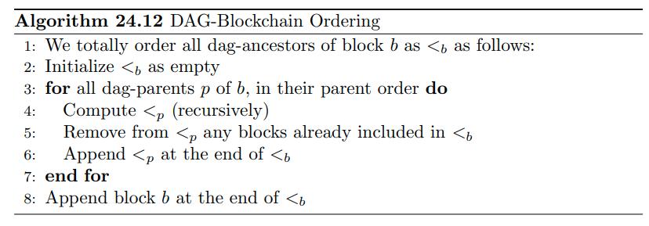
Ethereum DAG

Slide 36
Ethereum DAG
Create Tree relation : The tree parent of B is the first dag-parent in b’s parent order
Weight of block A w.r.t B = | DAG - ancestors(B) ⋂ Tree - descendents(A) |
= “number of ancestors of B that can be reached by travelling downwards through tree from A”
Parent Order of w.r.t B, with parents x,y:
x < y ⇔ “Let z be the lowest common tree-ancestor of x and y. x’ and y’ are the tree children of z that are tree-ancestors of x and y respectively. If x’ has a higher weight than y’ ⇔ x < y”

Slide 37
Ethereum DAG

Slide 38
Ethereum DAG
Tree relation
Dag Relation
What is the parent order of x and y?
y
x
B
Parent Order of w.r.t B, with parents x,y:
x < y ⇔ “Let z be the lowest common tree-ancestor of x and y. x’ and y’ are the tree children of z that are tree-ancestors of x and y respectively. If x’ has a higher weight than y’ ⇔ x < y”

Slide 39
Ethereum DAG
Tree relation
Lowest common tree-ancestor
Dag Relation
Z
What is the parent order of x and y?
y
x
B
Parent Order of w.r.t B, with parents x,y:
x < y ⇔ “Let z be the lowest common tree-ancestor of x and y. x’ and y’ are the tree children of z that are tree-ancestors of x and y respectively. If x’ has a higher weight than y’ ⇔ x < y”

Slide 40
Ethereum DAG
Tree relation
Lowest common tree-ancestor
Dag Relation
Z
What is the parent order of x and y?
tree-ancestor of y and child of z
x’
y =y’
x
B
Parent Order of w.r.t B, with parents x,y:
x < y ⇔ “Let z be the lowest common tree-ancestor of x and y. x’ and y’ are the tree children of z that are tree-ancestors of x and y respectively. If x’ has a higher weight than y’ ⇔ x < y”

Slide 41
Ethereum DAG
Tree relation
Lowest common tree-ancestor
Dag Relation
Z
Weight of x’? Weight of y’?
tree-ancestor of y and child of z
W(x’) = 1
x’
y =y’
W(y’) = 0
x
B
W(y’) < W(x’) => x is ordered before y
Weight of A w.r.t B = “number of ancestors of B that can be reached by travelling downwards through tree from A”

Slide 42
Ethereum DAG
1.
2.
4.
Not an ancestor of B
3.
5.

Slide 43
Ethereum smart contracts
Smart contract creation: A transaction with recipient with address 0 deploys a new smart contract
Smart Contract Execution Transaction: A transaction with a smart contract address in its recipient field and code to execute a function of that contract in its data field
Gas: I the unit of an atomic computation, i.e ADDing two numbers costs 3 Gas

