Slide 1
Collaborative Human Computing
Zack Zhu
March 31, 2010
Seminar for Distributed Computing
Notes:
Nature of talk:
Relaxing, not too technical
Goals:
introduction to idea
instigate some discussion
pique your enthusiasm
Remind audience to write down slide number

Slide 2

Distributed Computing...
Notes:
Traditionally:
DC spreads complex piece of computation to multiple machines

Slide 3
...redefined: Distributed Thinking
Notes:
Motivation: Humans > computers at some tasks
CHC: Harness the power of cognitive computation
Don‘t worry, your job security is as good as it‘s ever been

Slide 4
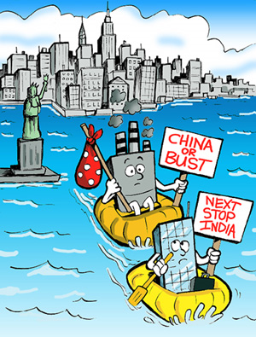
“Crowdsourcing”
+
Internet
Human Resource = $$$$$!!
+
Web 2.0
$
$
Notes:
How can we reduce HR cost? – ask the audience!
crowdsourcing := openly engaging the public to harness power of the masses

Slide 5

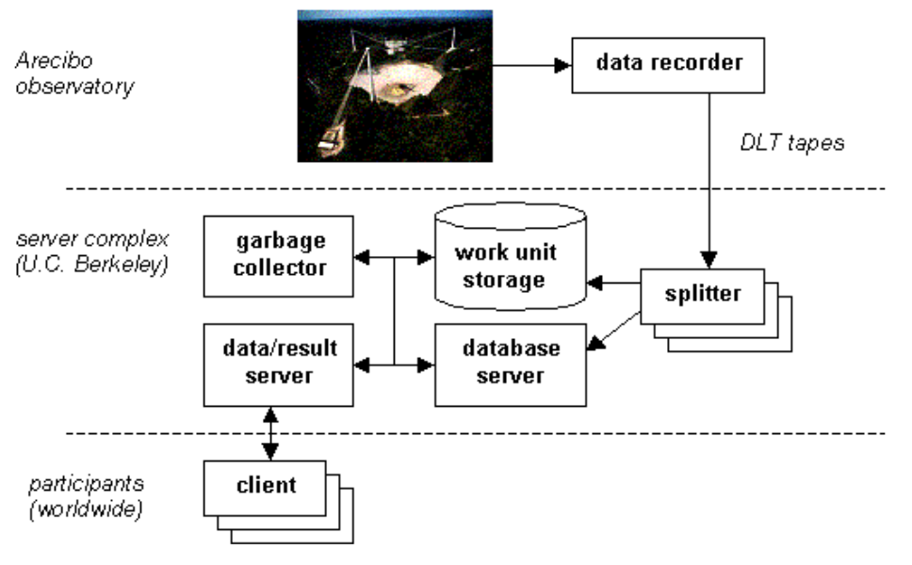
Crowdsourcing
Search for Extraterrestrial Intelligence
Earliest project utilizing the idea (launched in May 1999)
Voluntary distributed computing

Slide 6
Distributed Thinking
+
Crowdsourcing
Collaborative Human Computing

Slide 7






Collaborative Human Computing

Slide 8
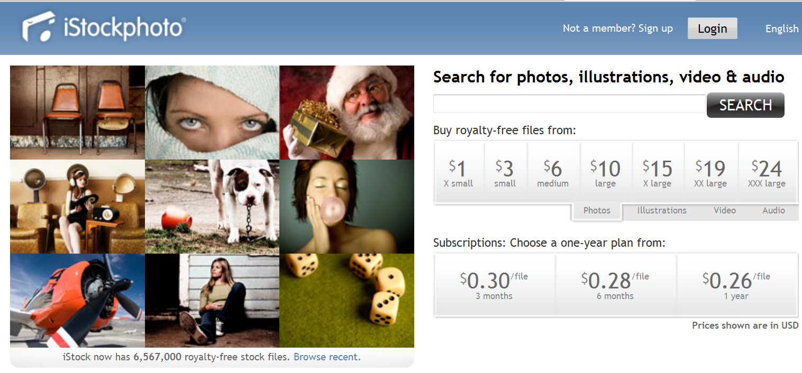
>3 million registered users
>6.5 million stock photos
Royalty-free (up to 500,000 prints)
Notes:
Forum where users contribute and purchase stock photos.
iStockPhoto capitalized on cheap, professional hardware and emerging technology in computational photography

Slide 9
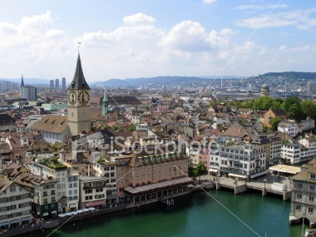
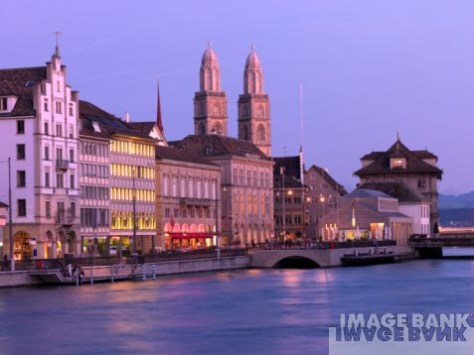
iStockPhoto:
~5-10 Chf/picture
Professional Stock Photo:
~400-600 Chf/picture

Slide 10

Crowdsourced R&D
Notes:
Corporate R&D is constantly engaged in the process
Innocentive provides “Rooms” where solvers can discuss/collaborate with a certain degree of privacy
Ownership of results remain with company (similar to agreement R&D scientists sign)

Slide 11
Why it works:
  Solver Diversity
  Workforce Mentality
  Vetted Input
Notes:
Diversity -> R&D labs look at the problem the same way, out-of-box thinking more likely when outside influences are introduced (methodology diversity)
->breakthrough/innovation likely to come from experts outside the problem domain (content diversity)
Workforce mentality -> more intrinsic motivation since solvers select their work

Slide 12
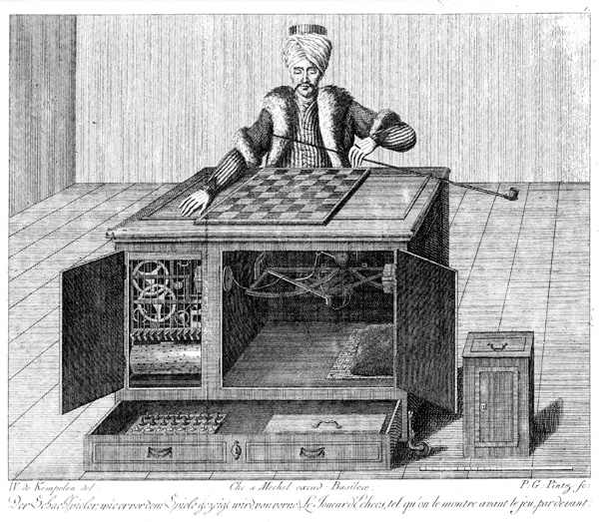
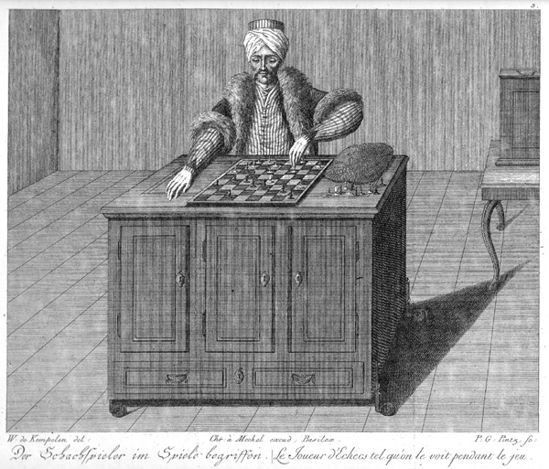
Notes:
By 18th century inventor: Wolfgang von Kempelen

Slide 13
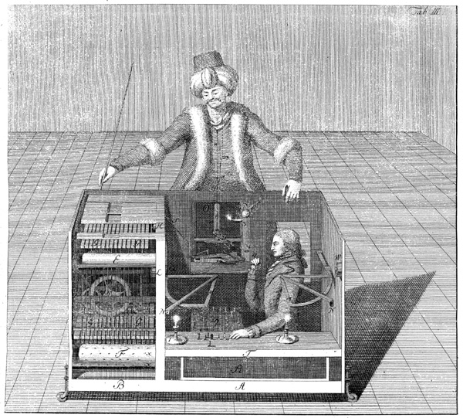

Slide 14
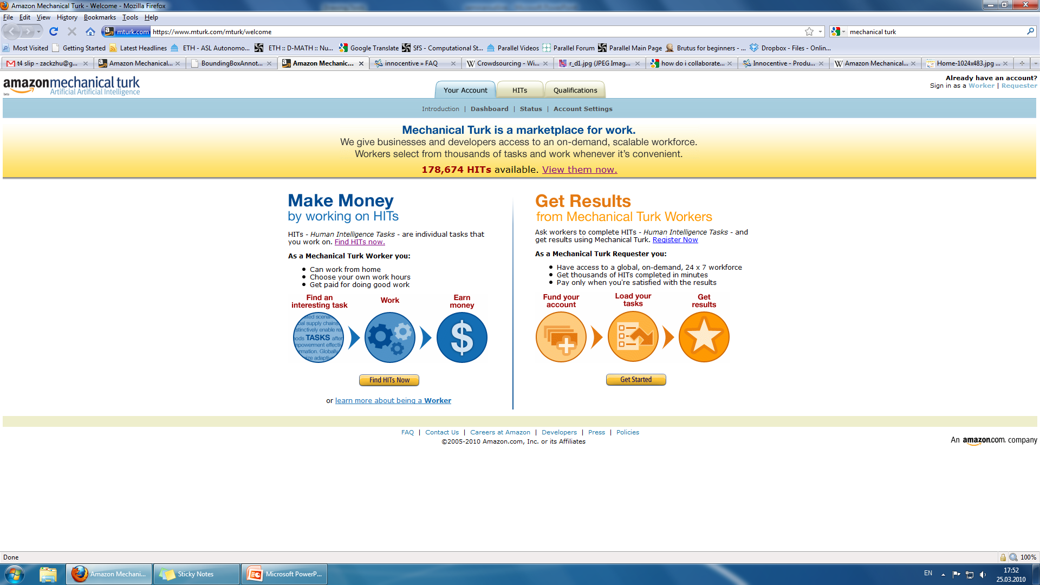
Mechanical Turk
Human Intelligence Tasks (HIT)
  Relatively trivial for users
  Difficult to automate
  Low payout: $0.01-$5/HIT
For example:
  Image tagging
  Write a review (movies, CDs)
  Rank a series of pictures
Virtual Sweatshop????
Notes:
Innocentive – lengthy, sophisticated R&D project. Reviews are mixed...maybe it’s too difficult to coordinate real-world research projects?
mTurk poses simpler tasks.

Slide 15
How about harnessing the power of masses for
FREE and Get Paid?
Notes:
Free->exchange

Slide 16
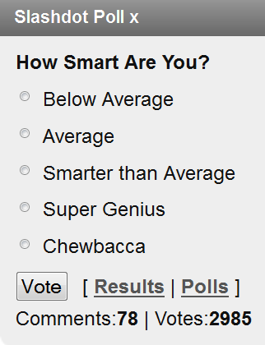
Notes:
Present the problem to demonstrate the genius in the solution

Slide 17
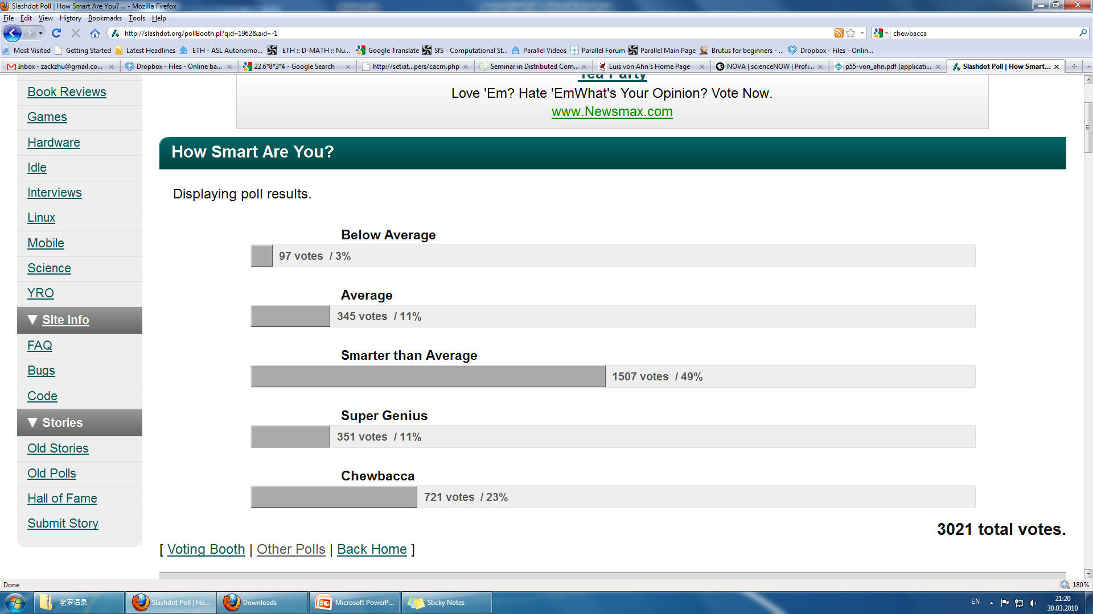
6,969,696,969 votes / 85%

Slide 18
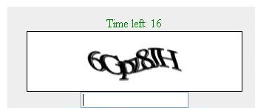
To see the next picture…
Lesson: Give the crowd something they need...
Notes:
Captcha is a turing test – list some applications, include obtaining free email accounts
Porn sites use social computation for evil.
If someone doesn’t break it – it does its job
If someone does break it – contribution to the cs research community, also good. But unlikely
Essence: Free->exchange

Slide 19
Initiative to digitize typeset text
  Today: OCR fails to recognize 20% of scanned text
How?
  Scanned page
  Decipher with 2 independent OCR programs
  List suspicious words (no consensus)
  Distort and send out as reCaptcha
Notes:
MC: spit into multiple slides to go into more technical details
Slides to emphasize technical stuff
How to verify a user’s input for the unknown word? -> user consensus
Human error -> discrepancies sent to additional users for consensus before digitizing
Talk about cheating (penis attack case)

Slide 20
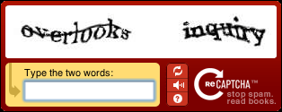
Control Word
(known from previous reCaptchas)
Unrecognized Word
  Enter unrecognized word into database
  (consensus established between n people)
Notes:
Control word gives the system some confidence
Talk about consensus

Slide 21
Is it secure?
More secure than conventional Captchas
  Anti-captcha algorithms
  100% Successful in failing anti-captcha algorithms
  Computer-generated Captcha 90% successful
1. Scanning Noise
2. Artificial Transformation
3. Natural Fading

Slide 22
Is it successful?
  Accuracy of 99.1%
    Human: 99%
    Standard OCR: 83.5%
  440 Million words deciphered in the 1st year (~17,600 books)
  35 Million words/day (March, 2009)
Notes:
How to verify a user’s input for the unknown word? -> user consensus
Human error -> discrepancies sent to additional users for consensus before digitizing
Talk about cheating (penis attack case)

Slide 23
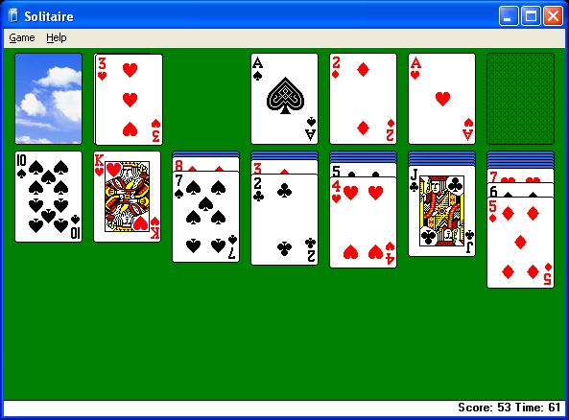
9 BILLION human-hours/year
Notes:
9 billion = 450 panama cannals

Slide 24
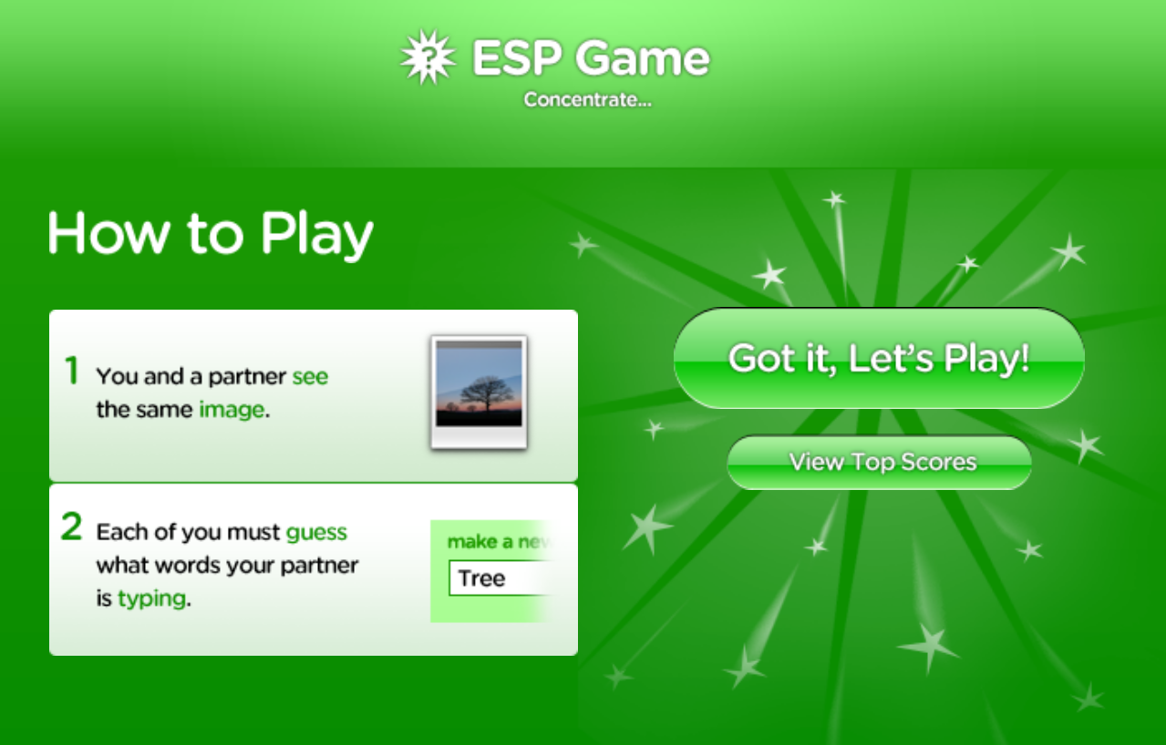
gwap
Notes:
Build interactive game for audience to play

Slide 25
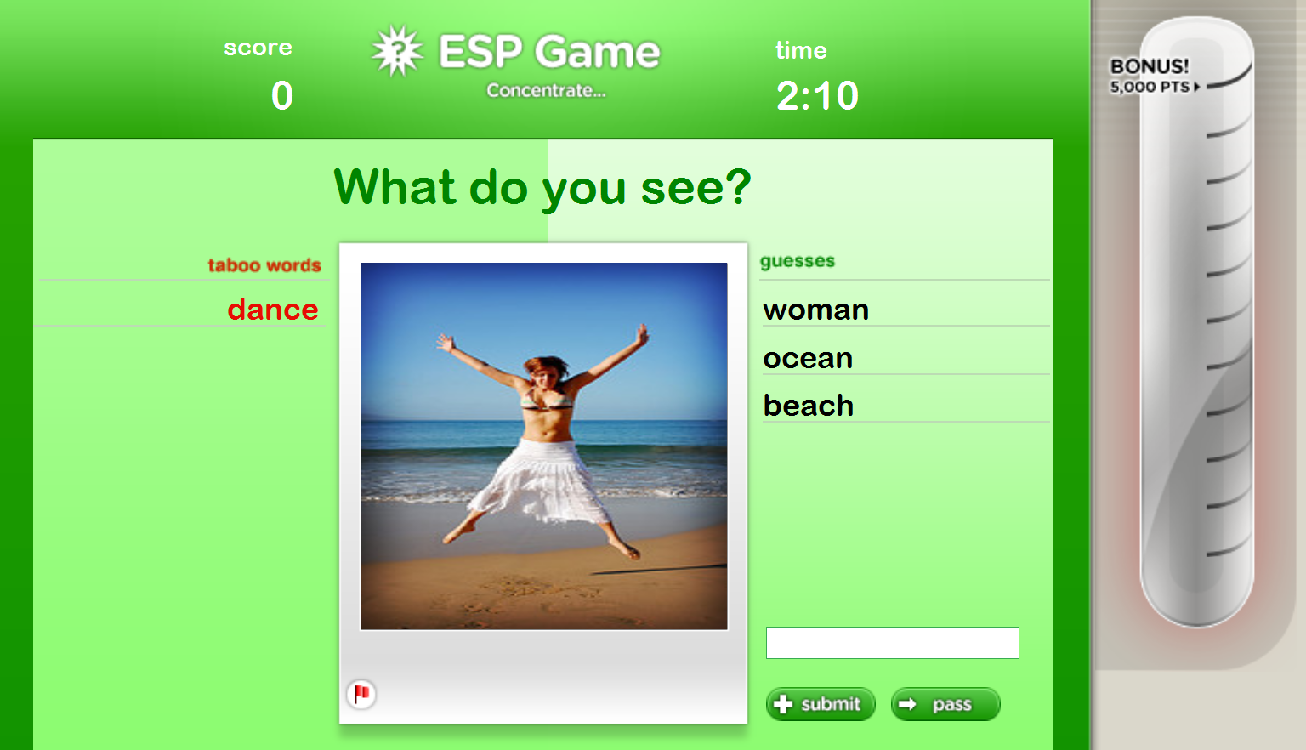
gwap
Image Tagging

Slide 26
Is it fun?
  15 million agreements (tags) from 75,000 players
  200,000 regular players
  Many people play >20 hours a week
  Playing streaks of >15 hours

Slide 27
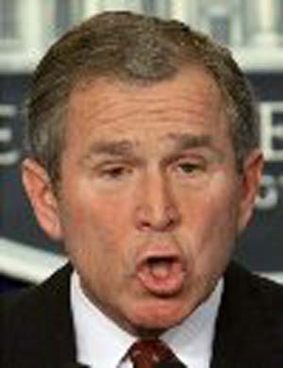
Why?
  Sense of connection with your partner
“...the two of you are bringing your minds together in ways lovers would envy.”
Bush
President
Man
Yuck

Slide 28
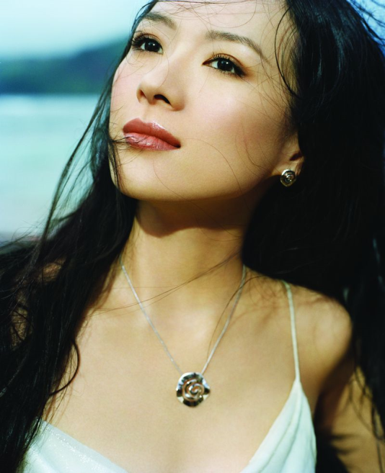
Single Player Version?
Record moves of players with time stamps
Play pre-recorded moves
ESN Game
  Moves recorded (Player A):
  (0:02) goddess; (0:03) ziyi
  (0:04) thoughtful; (0:08) hot
Taboo Words | Time | Player 1 | Bot (Player A)
Woman | 0:01 | ziyi
Beautiful | 0:02 | asian | goddess
Gorgeous | 0:03 | model | ziyi
Notes:
Important because:
Odd number of players/Connection problem
Cheating prevention – seed images with honest user behaviour known -> compare against user in question
Solves the bootstrap problem – users will use it only if it’s meaningful, but the program needs users to be meangingful

Slide 29
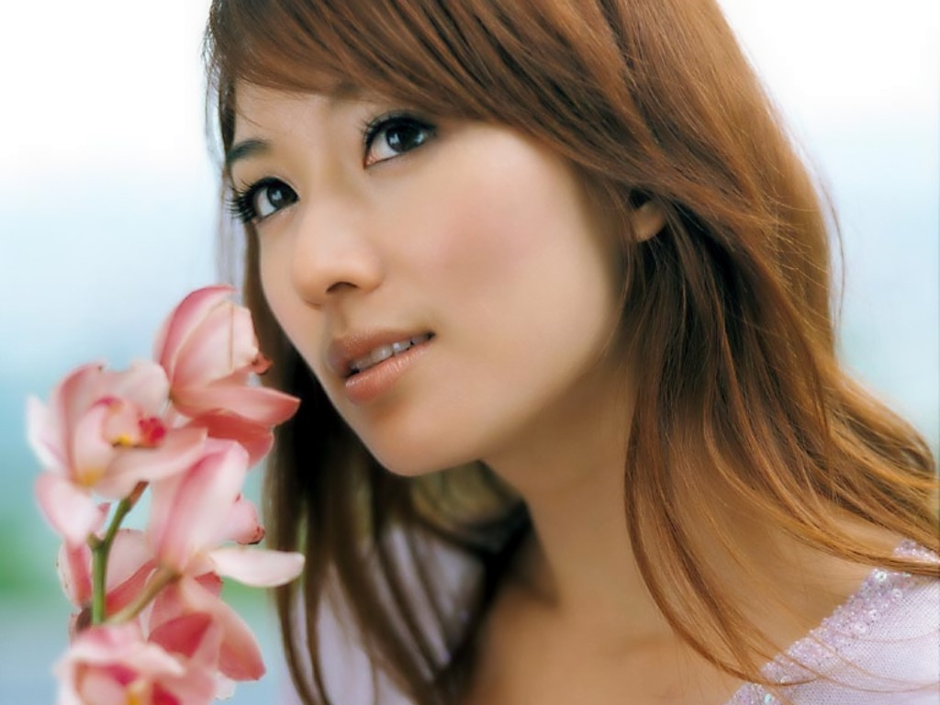
…0 Player?
Moves recorded
Bot 1: (0:02) goddess; (0:04) face; (0:08) hot (0:14) flowers
Bot 2: (0:01) flowers; (0:02) model; (0:03) asian; (0:09) girl

Slide 30

Generalization
Game <-> algorithm: Input-Output
Symmetric/Parallel:
n player completing the same task
Player 1: “pear, orange, apple”
Consensus
(e.g. ESN Game)
Store: apple
Player 2: “…apple…”
Notes:
Problem arises when there exists too many possibilities for the input

Slide 31
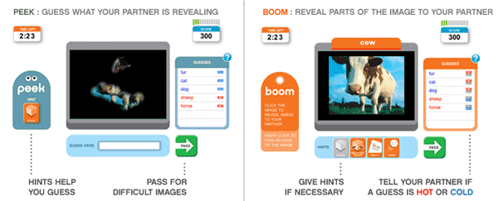

Slide 32

Tusk
Ear
Trunk/Tusk/Ear
User-Created
Pings
Trunk
Notes:
Make connection to esp game (source of tags)

Slide 33
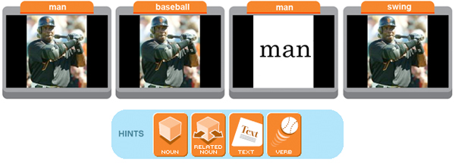
Hints:

Slide 34
Generalization
Asymmetric/Sequential:
Player 1’s output fed to Player 2’s input
Player 1’s Task
Player 2’s Guess
“Object”
“Object”
Notes:
Problem arises when there exists too many possibilities for player 1’s output
Better interaction -> more engaging

Slide 35
Security Measures
Pretty standard …
Player queue
IP Check (location proximity)
Notes:
Split measures into multiple slides!!
Communication monitoring a big problem, no suitable solution yet
-passing of IM/email -> dealt with by limiting words to dictionary words, alphabet characters only

Slide 36
Security Measures
More interesting…
Test image/behaviour matching
Aggregated consensus
reCaptcha the gwap games?

Slide 37
References
L. von Ahn, M. Blum (2006). Peekaboom: A game for locating objects in images. In ACM CHI.
L. von Ahn, B. Maurer, C. McMillen, D. Abraham, and M. Blum. “reCAPTCHA: Human-Based Character Recognition via Web Security Measures.” Science, September 2008.
J. Howe. “The Rise of Crowd Surfing”, Wired, June 2006.
D. P. Anderson , J. Cobb , E. Korpela , M. Lebofsky , D. Werthimer, “SETI@home: an experiment in public-resource computing,” Communications of the ACM, v.45 n.11, p.56-61, November 2002 .
gwap, http://www.gwap.com
Amazon Mechanical Turk, https://www.mturk.com/mturk/welcome
Google Tech Talk, http://www.cs.cmu.edu/~biglou/

Slide 38
Discussion
Net productivity?
Declining popularity with time, repackagable?
…your input?
Notes:
Net productivity: trivial/fun tasks distracting us from ‘real’ work? Does society lose its productivity as a whole?
Games go out of style fast

